Slide 1
A close-up view of synchrotron diversity from a user’s viewpoint
Dennis Stegmann
MXCuBE-ISPyB joint Meeting, Harwell Campus, 19 November 2025

Slide 2
Contents
Crystal based ligand screening – lots of samples
Prepare an experiment online
User portals
A-forms
Metadata transfer
Retrieving data
MXLIMS
Notes:
I qould like to day to convey an impression of the experience of setting up a ipment from a user perspective in eximx or ispyb. Most figures here are extracted from sops and guides written for myself to reember how to use the specific ipyb setup, or from an initial attempt to extract , respectively from an attempt to extract most reelvant fields required to set up a sample shipment, as also as the time is not sufficient to come even close to a xomparison between the different ispyb setups that we have used.
After introducing our setup very briefly, I would like to go over the processs of setting up a shipment of classic samples and how we extracted fields and finish with a brief introduction to rasmus detailed explanation of MXLIMS

Slide 3
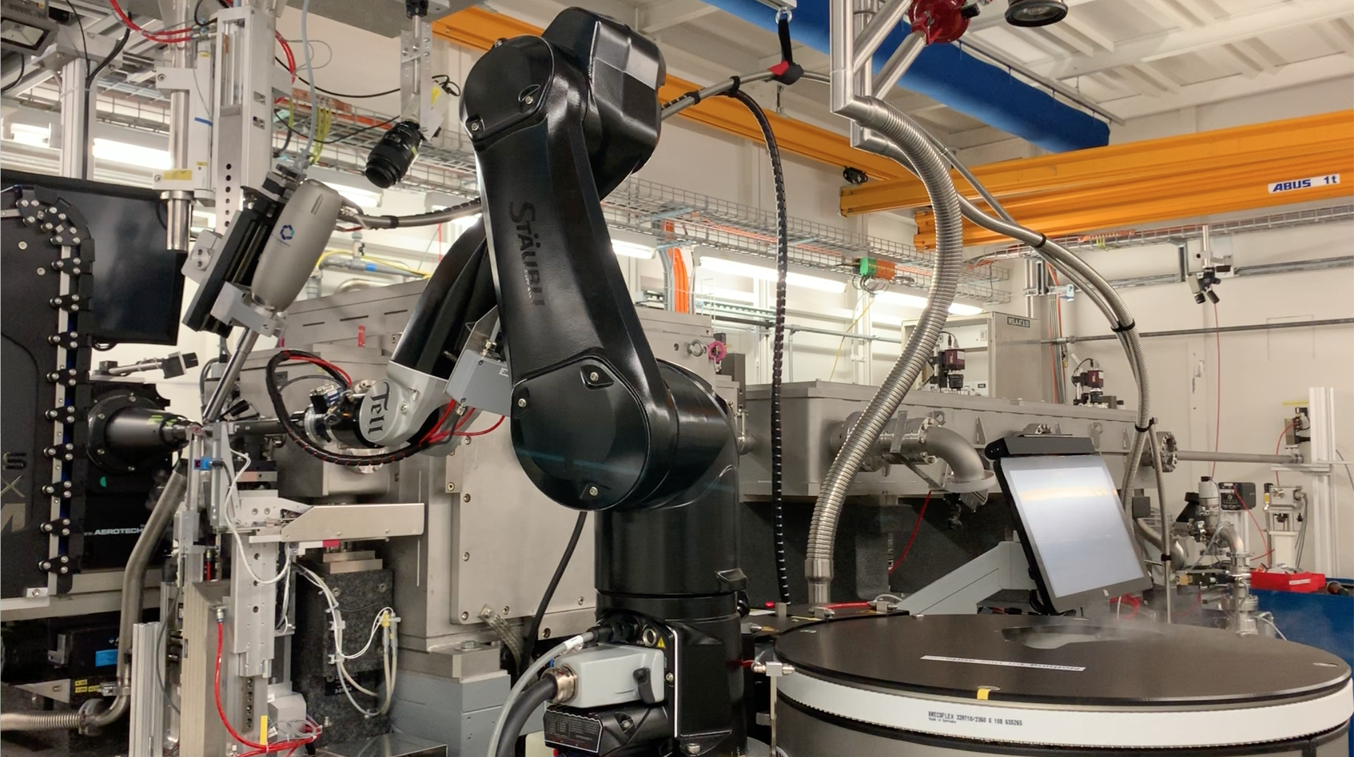
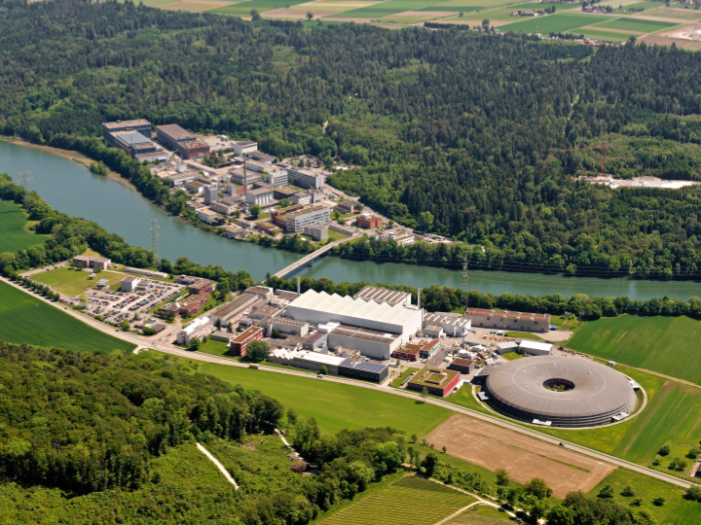
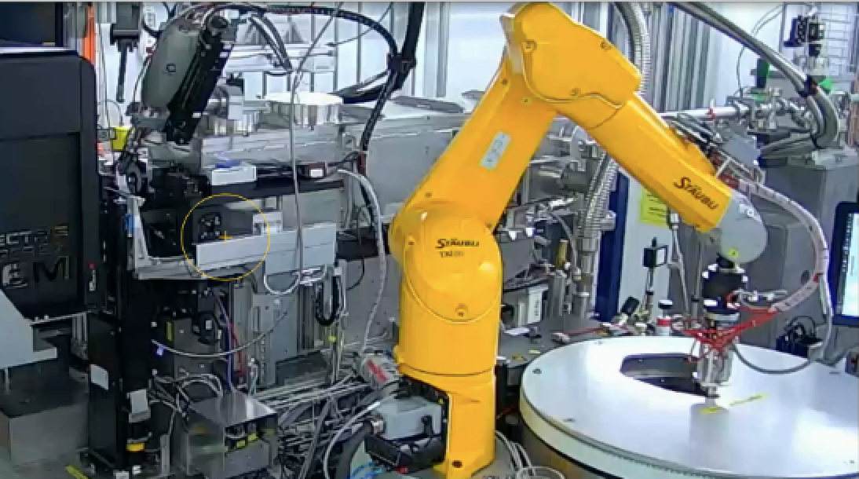
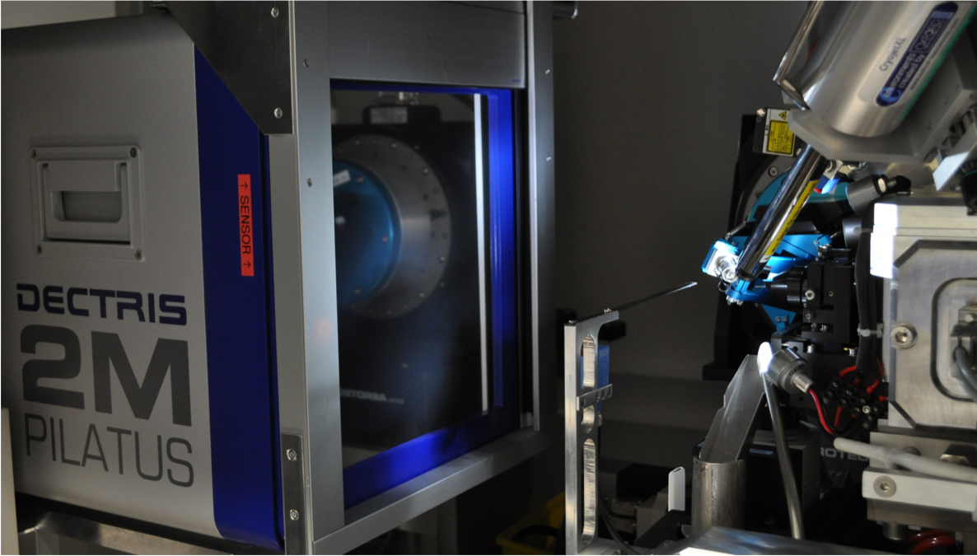
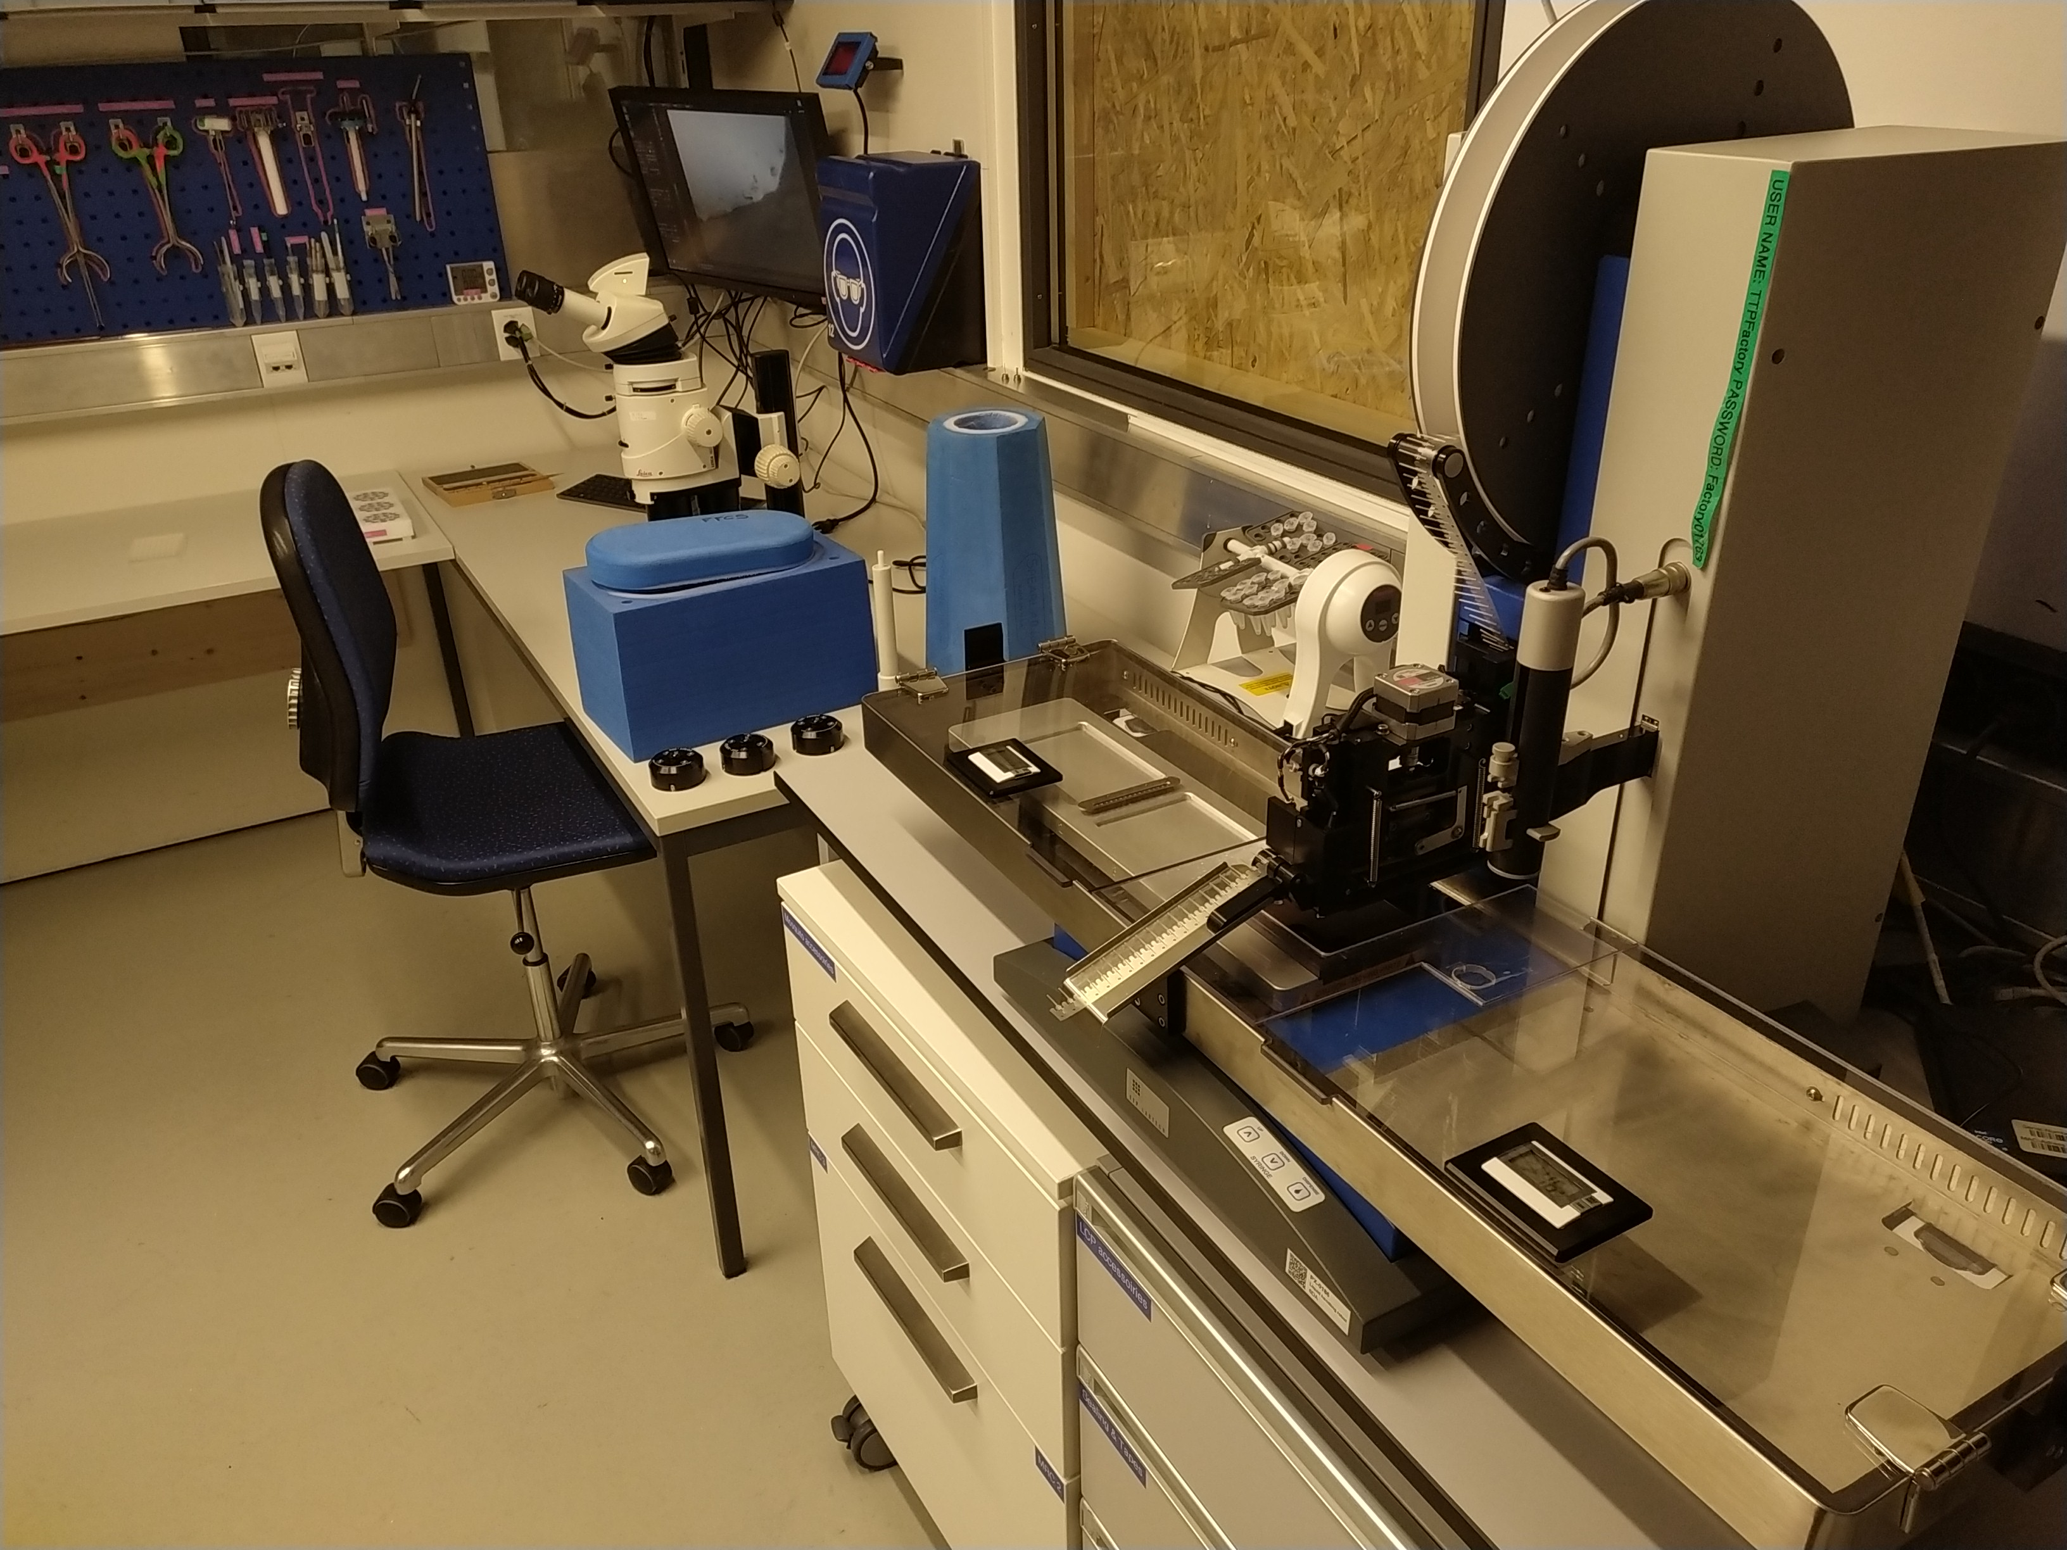
SLS: Upgrade electron storage ring
 | PXI (X06SA) | PXII (X10SA) | PXIII (X06DA)
Wavelength range [Å] | 0.7 - 2.2 | 0.62 - 2.07 | 0.71 - 2.07
Source | in-vacuum undulator | in-vacuum undulator | bending magnet
Spectral range [keV] | 5.7 - 17.5 | 6.0 - 20.0 | 6.0 - 17.5
Flux at 12.4 keV [ph/s] | > 2 x 10¹² | > 2 x 10¹² | 5 x 10¹¹
Focused spot size h x v [μm²] | 5 x 5 (2 x 1) -> 100 x 100 | 70 x 15 (30 x 10) | 80 x 45
Detector | EIGER 16M | EIGER2 16M | PILATUS 2M-F
Frame rates [Hz] | 133 750 (4M ROI) | 130 500 (4M ROI) | 60
Goniometer | multi-axis SmarGon-MSC2 | multi-axis SmarGon-MSC2 | multi-axis PRIGo
Robot & pucks | TELL Unipucks | TELL Unipucks | TELL Unipucks
SwissMX
Endstation
PXI
SwissFEL
No beam
PXII
SLS
PXIII
PX beamlines under reconstruction until Q2 2025 / Q2 2026
Storage ring upgrade
Crystallization Facility / FFCS runs nevertheless
CF

Slide 4





Seeking Light Elsewhere
(Thanks for all the patience!)
Proposals
Sample shipping
Learning to operate new beamlines
Retrieving data
Notes:
We at least tried to learn how to write proposals, ship samples, how to operate other beamolines and how hot get our data back and into our system

Slide 5
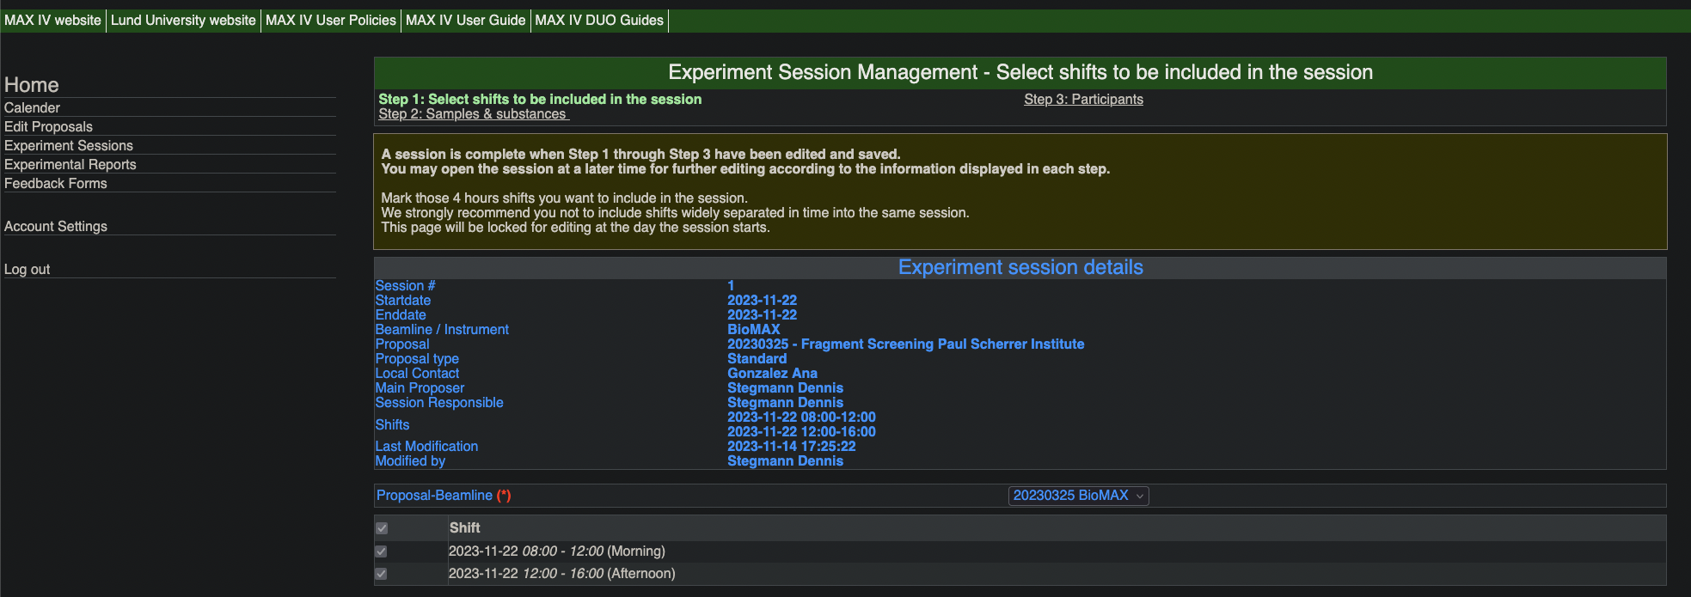
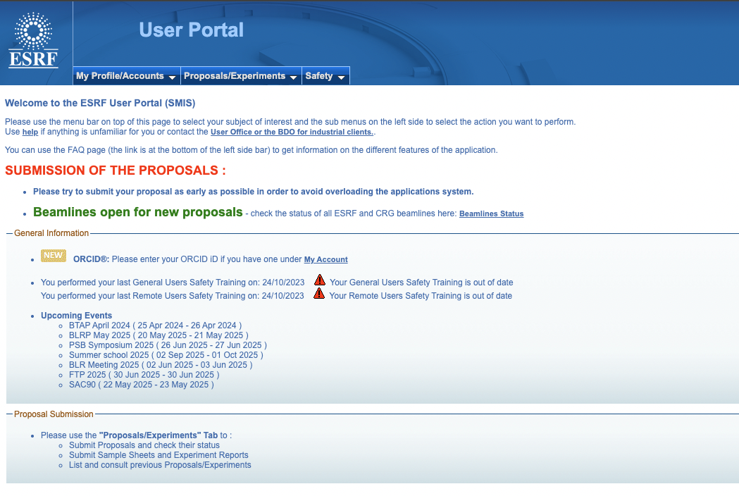
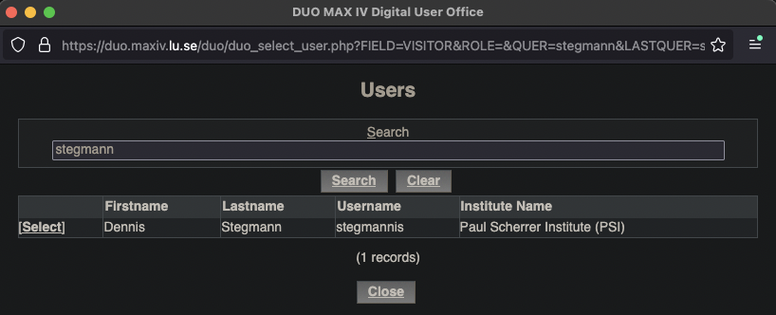
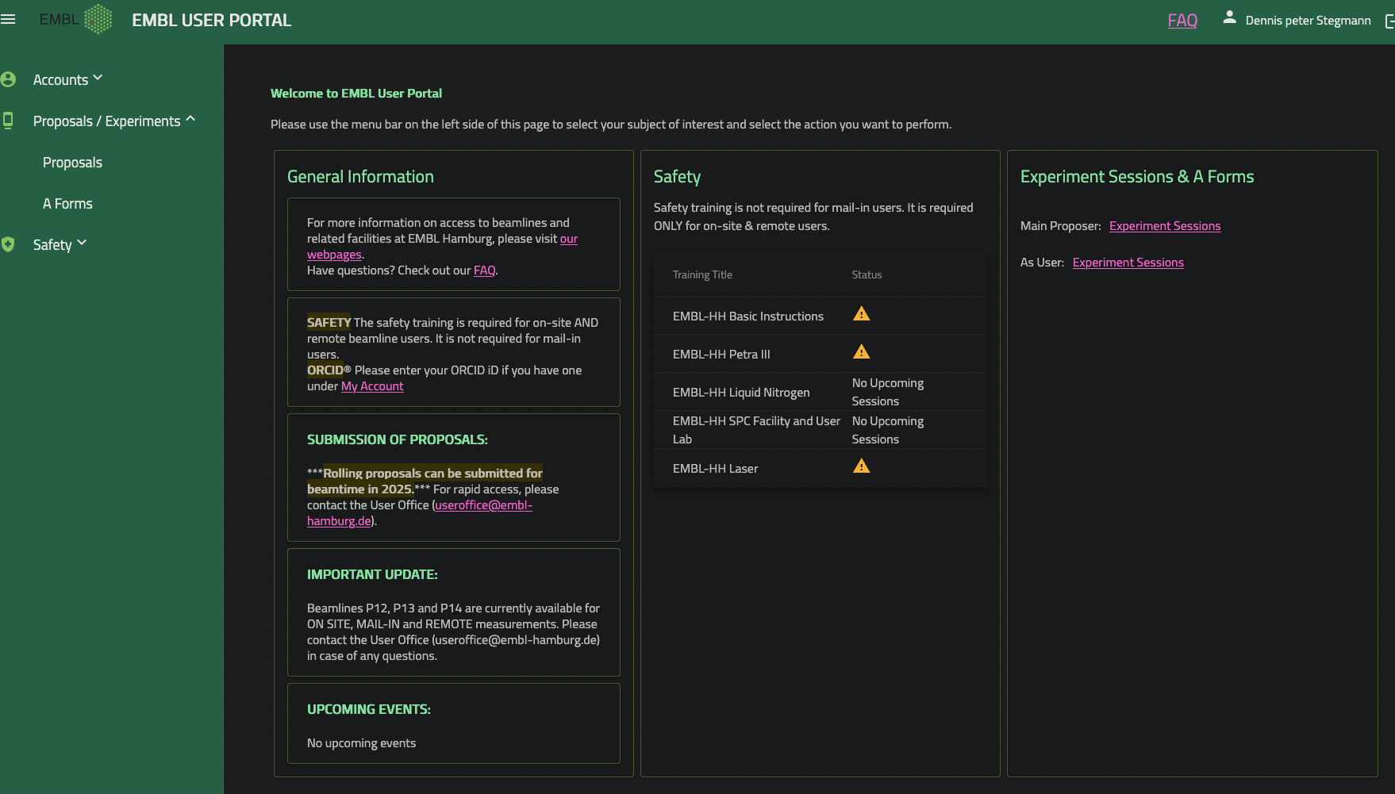
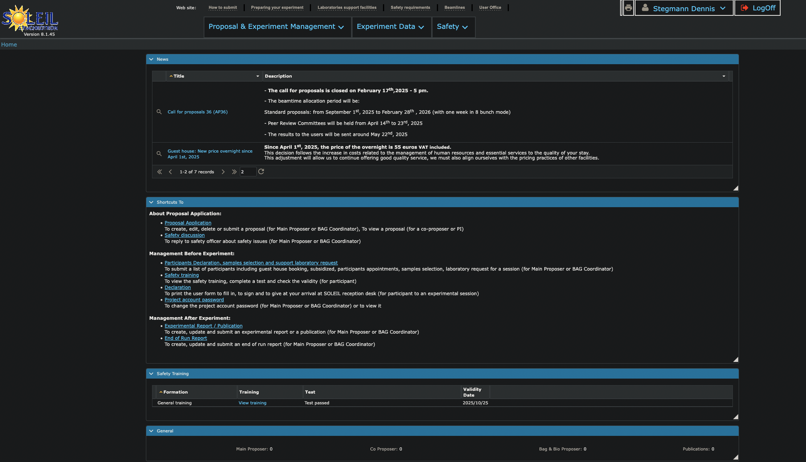
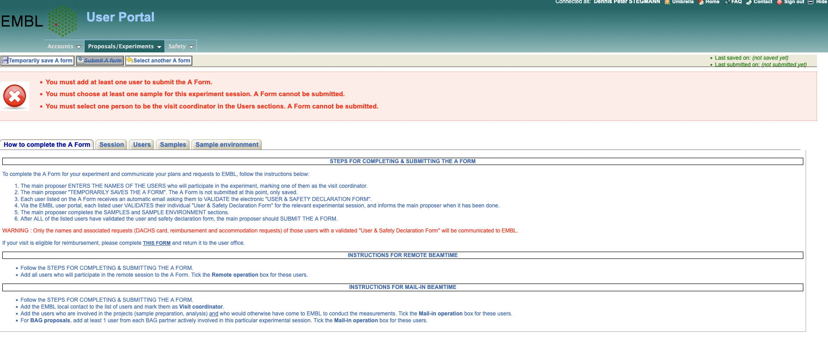
User Portals: proposals, substances, accomodation, experimenters
Notes:
The very first and first step for setting up experiments begins at the user portals of the individual synchrotrins.
These interfaces are site specific setups to handle proposal application and status, sunstance risk assesment, but also user accomodaiton during experiments and user registration and participation

Slide 6
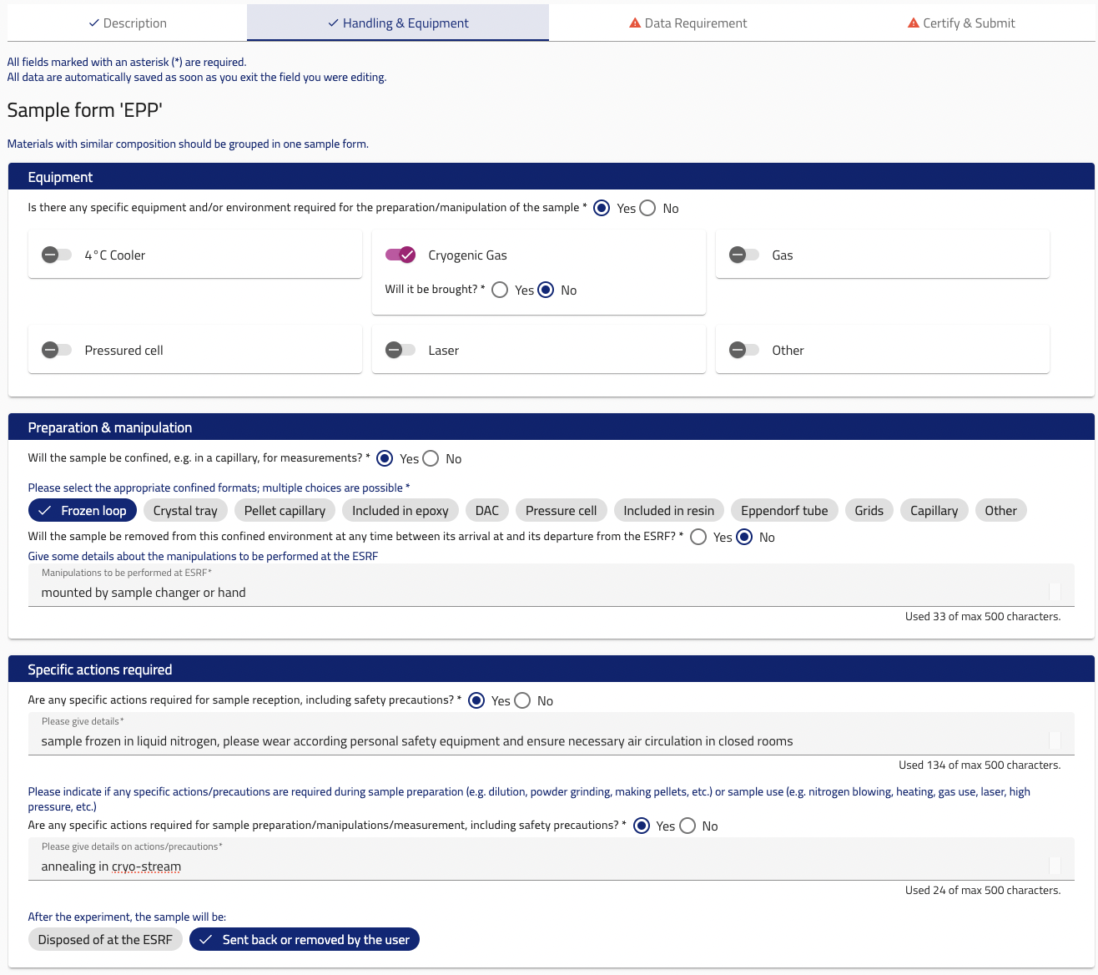
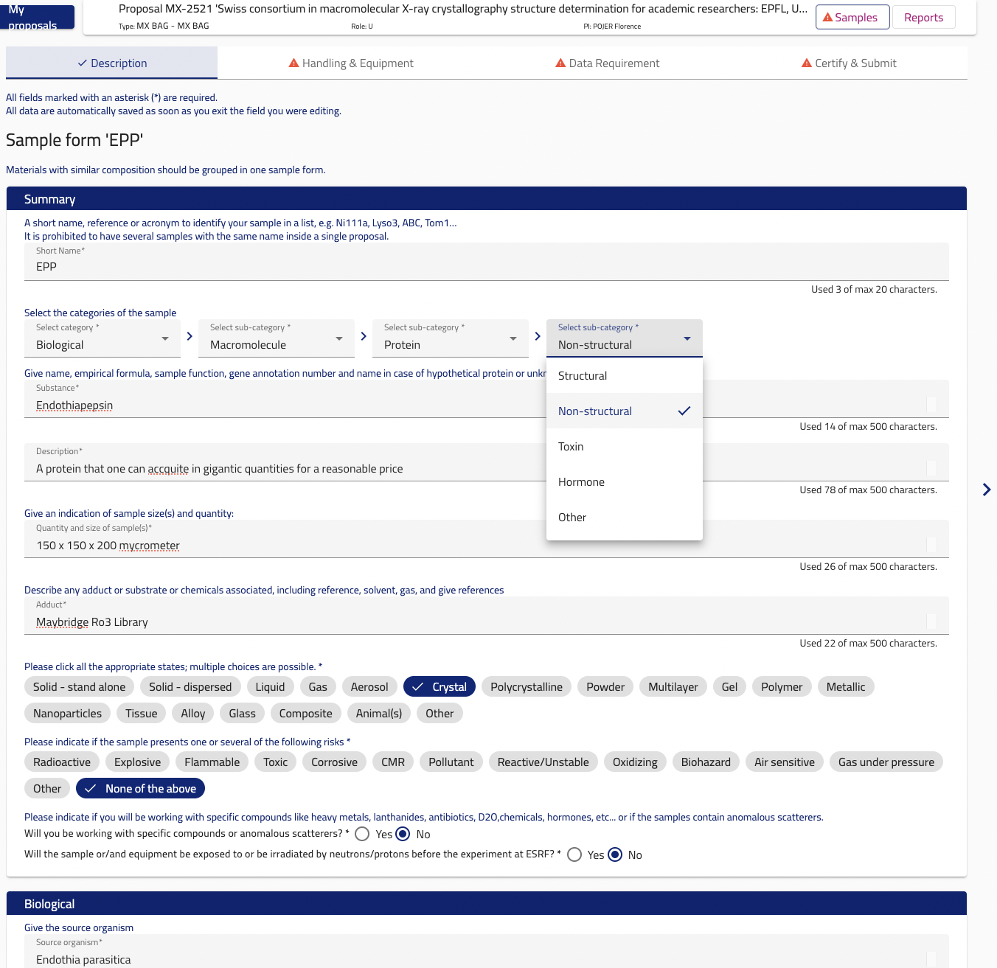
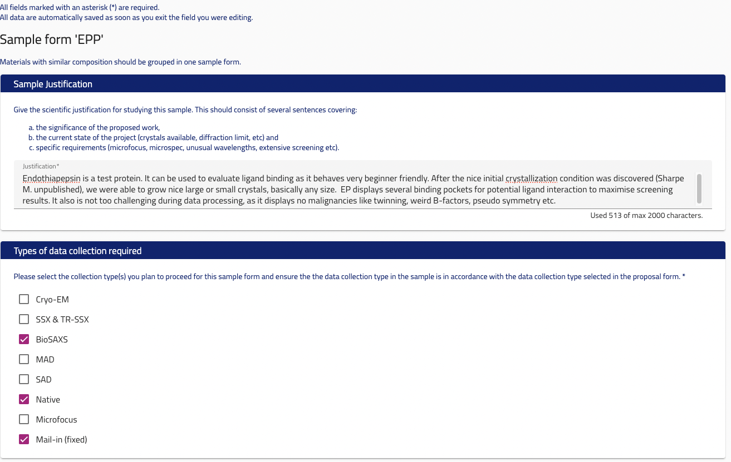
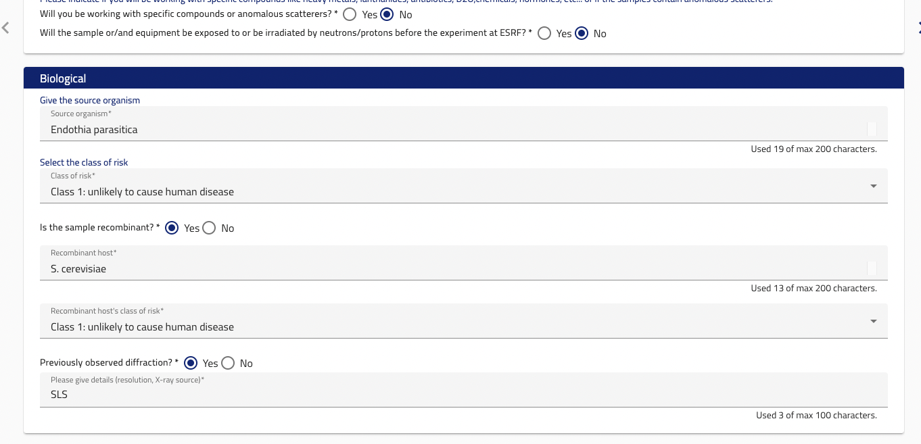
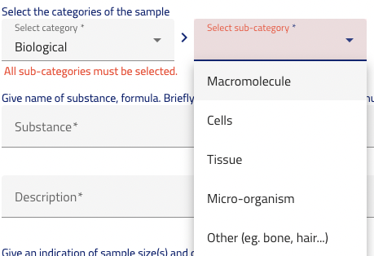
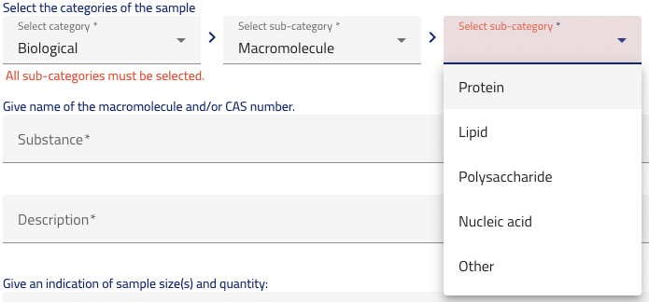
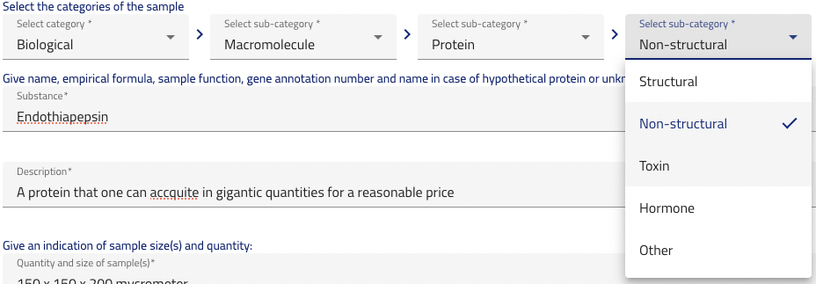
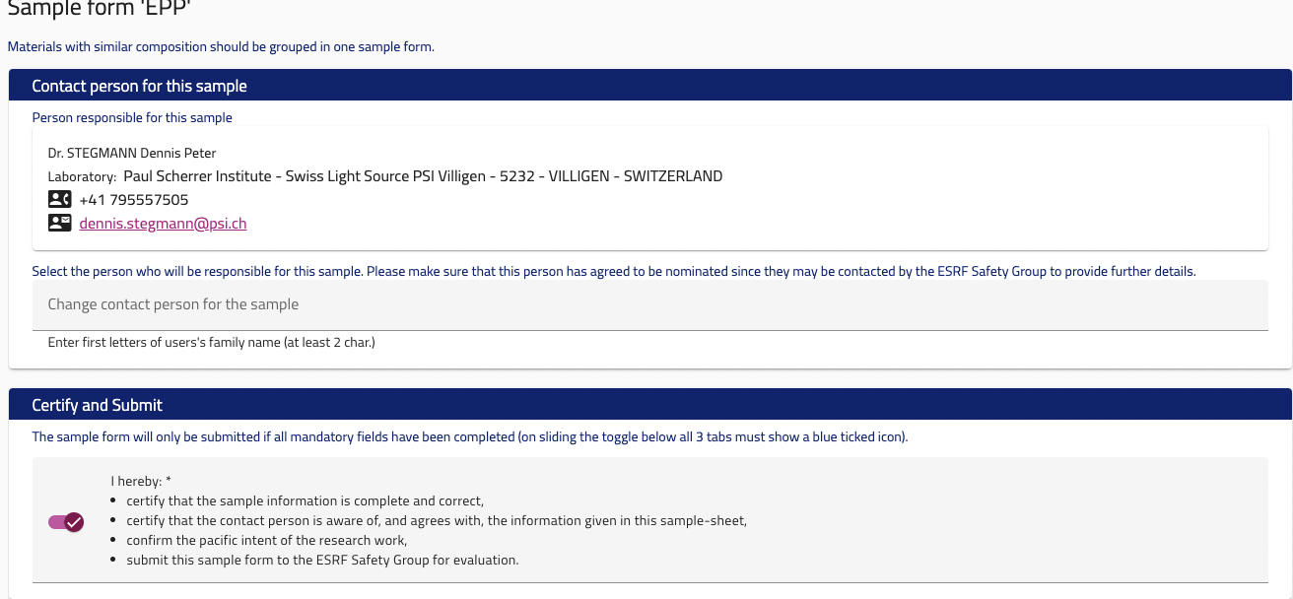
User Portals: input probably difficult to standardise
Proposal system & safety department
Substances: sign of from safety office & proposal review
Sometimes possible to add more substances later to a proposal
Authorisation needs to be conveyed to experimental metadata portal
Users/Experimenters
Responsibles for proposals, shifts & experiments
Accomodation for on-site users
Online safety training
Needs to be flexible enough for all beamlines/experiments on site, also non-MX
different sites, different security requirements in different countries,
-> compromise difficult
Notes:
STHere is probably two kinds of objects that can be extracted fhere, sunbstances and userafety training of all experimeners required, aslo for remote experiments

Slide 7
User Portals: connected to the database
Potential classes:
User
ApprovedSample
RequestedSample?
class User(BaseModel): # defined during registration
firstName: str
lastName: str
email: str
address: str
insitute: str | Institute
phoneNumber: str
class ApprovedSample(BaseModel):
substanceName: str
chemicalformula: str | None = None
substanceDescription: str | None = None
casNumber: str | None = None
sampleAggregateState: Literal["Liquid","Single Crystal", "Gas", "Solid/Powder", "Solid/Piece(s)"]
sampleSizeX: tuple[float, Literal["μm", "mm", "cm"]]
sampleSizeY: tuple[float, Literal["μm", "mm", "cm"]]
sampleSizeZ: tuple[float, Literal["μm", "mm", "cm"]]
sampleFate:Literal["Removed by user", "Disposed by Synchrotron"]
radiationSafety: bool
previousIrradiation: bool
radioactiveSample: bool
chemicalHazard: list[Literal["Explosive Danger", "Flammable Danger", "Oxidizing danger", "Compressed Gas Danger", "Corrosive Danger", "Toxic Danger", "Health Hazard Danger", "Environmental Hazard Danger" ]]
biologicalHazard: bool
isProtein: bool
sourceOrigin: str
isRecombinaint: bool
expressionHost: str | None = None
isToxin: bool
isVirulenceFactor: bool
isPrion: bool
derivative: str | None = None
containsHazardousLigands: bool
isBacteriumOrVirusAndInactive: bool
bioSafetyLevel: Literal[1, 2, 3, 4]
otherHazards: bool
involvesHumanTissue: bool
involvesAnimals: bool
class ApprovedSample(BaseModel):
acronym: str
kindSample: Literal["Chemical/Matter", "Biological", "Animals", "Other"]
subCathegoryKind: Literal["Macromolecule", "Cells", "Tissue", "Micro-organism", "Other"]
subsubCathegoryKind: Literal["Protein", "Lipid", "Polysaccharide", "Nucleic acid", "Other"]
subsubsubCathegoryKind: Literal["Structural", "Non-Structural", "Toxin", "Other"]
substance: str = Field(description="name of substance, formula, CAS number if exisiting etc")
sampleDescription: str = Field(description="more verbosde description")
sampleState: Literal["Solid – stand alone", "Solid – dispersed", "Liquid", "Gas", "Aerosol", "Polycristalline", "Powder", "Multilayer", "Gel", "Polymer", "Metallic", "Nanoparticles", "Tissue", "Alloy", "Glass", "Animals", "Other"]
sampleRisks: Literal["Radioactive", "Explosive", "Flammable", "Toxic", "Corrosive", "CMR", "Pollutant", "Reactive/Unstable", "Oxidizing", "Biohazard", "Air sensitive", "Gas under pressure"]
sourceOrganism: str
riskGroup: Literal[1, 2, 3, 4]
isRecombinant: bool
recombinantHost: str
hostRiskGroup: Literal[1, 2, 3, 4]
previouslyObservedDiffraction: bool
radiationSource: str
specificEquipmentOrEnvironment: bool
equipmentAndEnvironment: Literal["4 deg C Cooler", "Cryogenic Gas", "Gas", "Pressured Cell", "Laser", "Other"]
sampleConfined: bool
confindedIn: Literal["Frozen loop", "Crystal tray", "Pellet capillary", "Included in epoxy", "DAC", "Pressure cell", "Included in resin", "Eppendorf tube", "Grids", "Capillary", "Other"]
manipulationAtESRF: str
specificActionsReceptions: bool
specificActionsReceptionString: str
specificActionsExperiment: bool
specificActionsExperimentString: str
afterExperimentHandling: Literal["Disposed of at the ESRF", "Setn back or removed by the user"]
sampleJustification: str
typesDataCollection: Literal["Cryo-EM", "SSX & TR-SSX", "BioSAXS", "MAD", "SAD", "Native", "Microfocus", "Mail-in (fixed)"]
responsibleLabContact: User
class ApprovedSample(BaseModel):
proteinName: str
acronym: str
sampleOrigin: str
sampleAggregateState: Literal["a crystal", "a powder", "a solution", "a bulk"]
sampleMass: float = Field(..., description="[g]")
sampleVolume: float = Field(..., description="[cmˆ3]")
NumberSamples: int
isRecombinant:bool
isActiveVirus:bool
hostRiskGroup: Literal[1, 2, 3, 4]
isVirulenceFactor:bool
isPrion:bool
isToxin:bool
healthRiskHuman:bool | Literal["probably"]
environmentalRisk:bool | Literal["probably"]
isDangerous: bool | Literal["probably"]
samplePreparedOutsideSoleil:bool
sampleManipulationAtSoleil:bool
sampleTransportState:Literal["frozen", "in crystallization tray", "mounted in capillary","other sample holder"]
sampleFate:Literal["Stored at Synchrotron", "Took away by the user"]
class ApprovedSample(BaseModel):
kindSample: Literal["bioChemistry", "chemical", "cellularBiology"]
proteinName: str
acronym: str
sampleOrigin: str
sampleAggregateState: Literal["a crystal", "a powder", "a solution", "a bulk"]
sampleMass: float = Field(..., description="[g]")
sampleVolume: float = Field(..., description="[cm3]")
NumberSamples: int
isRecombinant:bool
isActiveVirus:bool
hostRiskGroup: Literal[1, 2, 3, 4]
isVirulenceFactor:bool
isPrion:bool
isToxin:bool
healthRiskHuman:bool | Literal["probably"]
environmentalRisk:bool | Literal["probably"]
isDangerous: bool | Literal["probably"]
samplePreparedOutsideSoleil:bool
sampleManipulationAtSoleil:bool
sampleTransportState:Literal["frozen", "in crystallization tray", "mounted in capillary","other sample holder"]
sampleFate:Literal["Stored at Synchrotron", "Took away by the user"]

Slide 8

Who and what will visit the beamline: A-Form or UserPortal
Good if all experimenters are in the same room and have time to set it up in one go
Vacation/illness/stress of one participant can delay shipments, especially for BAGs
In principle usually relatively easy to fill in after doing this for a while and knowing where to click
Ideally, users would have their samples ready weeks in advance, noone would be on vacation and FedEx would not occasionally need one week extra to deliver parcels
Important to declare upfront, who and what will be at the beamlines
Narrow alley in Küssnacht, Switzerland

Slide 9
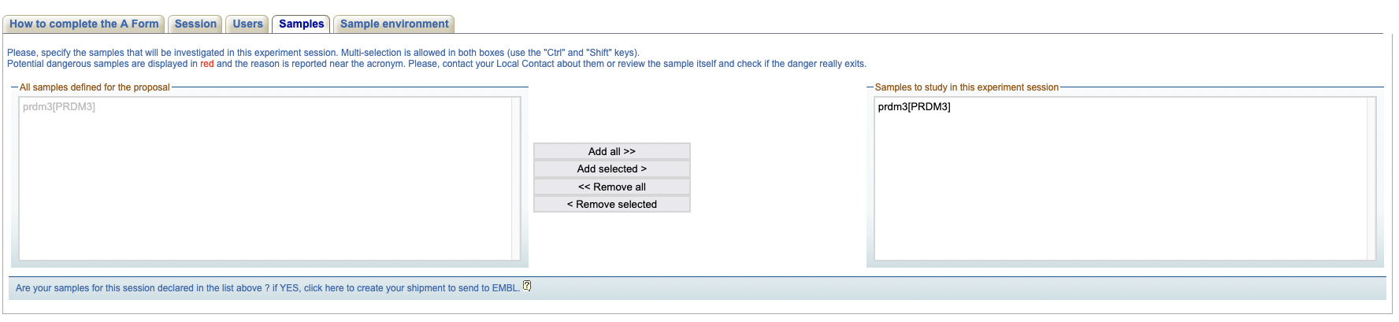
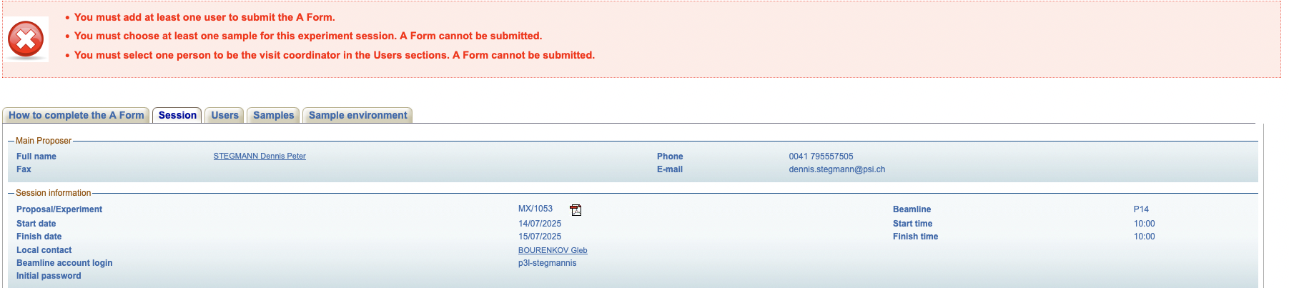
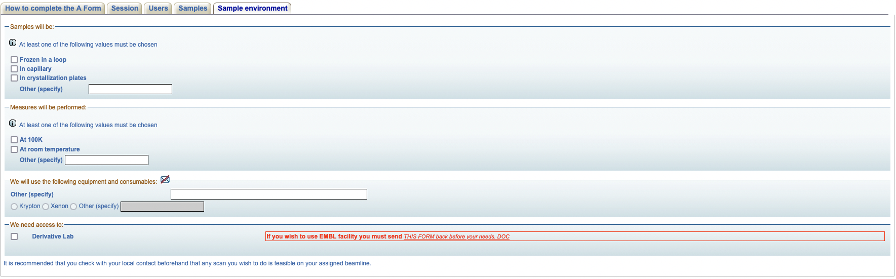
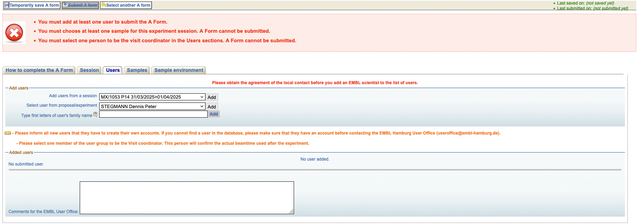
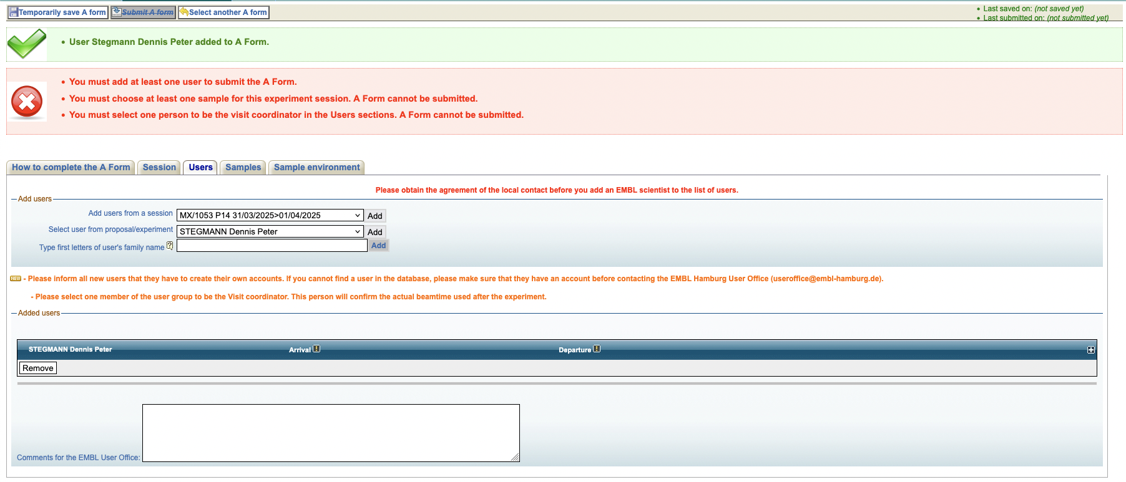
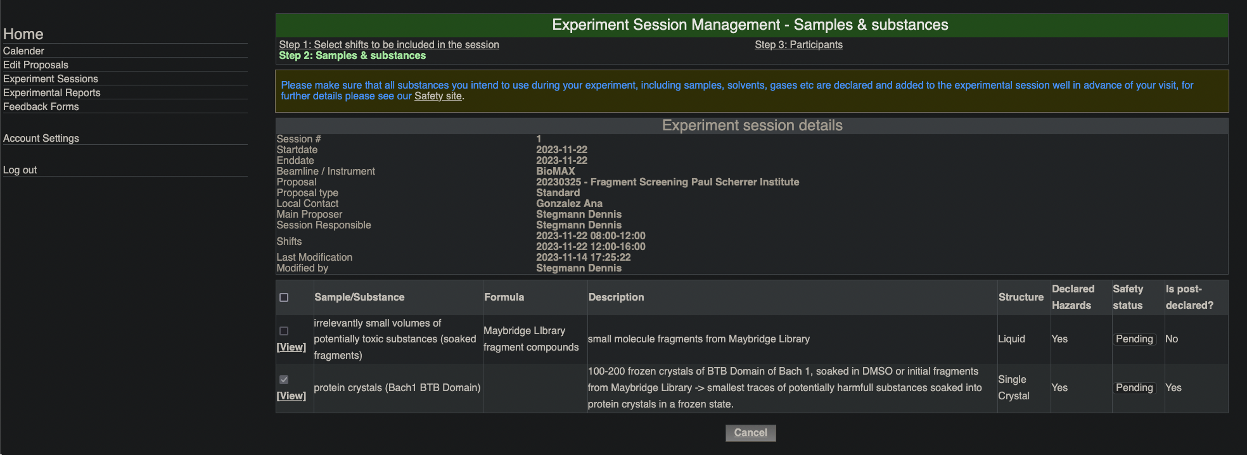
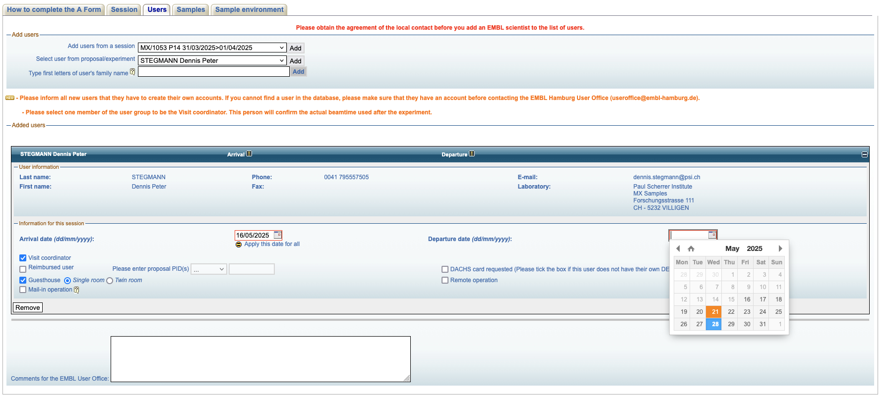
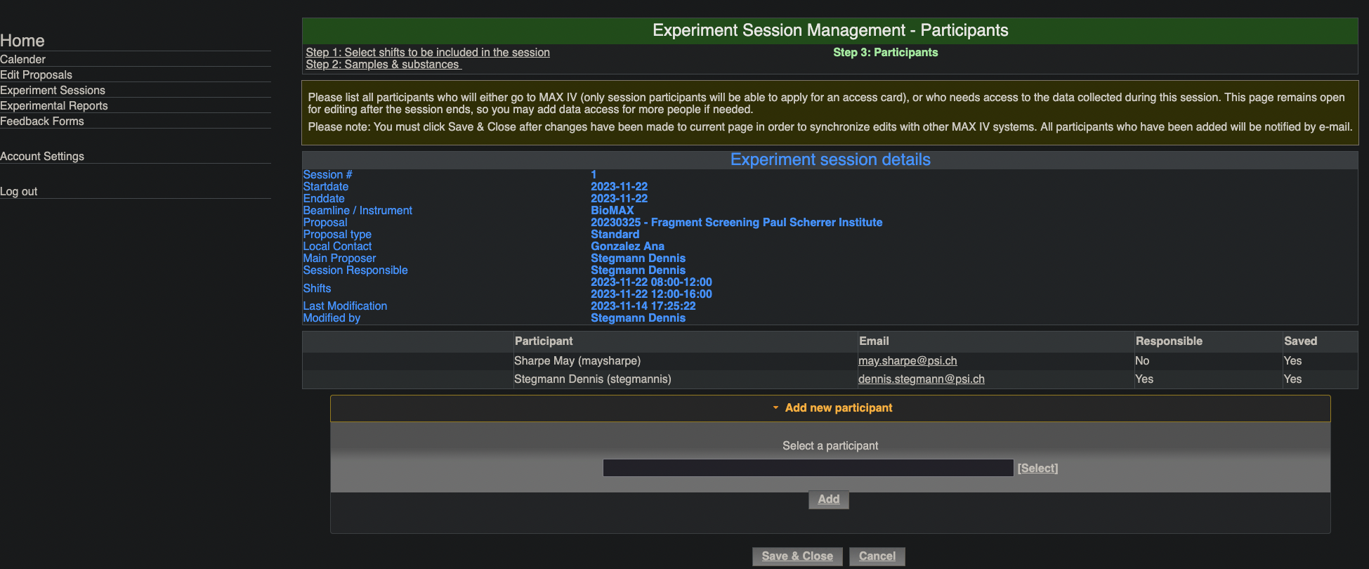
The A-Form: examples
Add “general”, safety approved samples for this beamtime
General beamtime info, nice and usefull
class AForm(BaseModel): # Set up by the MAIN(!) proposer. Only they can set this up, including allowed samples and users.
users: list[User]
comments: str
arrivalDate: datetime
departureDate: datetime
userisCoordinator: bool
guestHouse: tuple[bool, Literal("Single Room", "Twin room")]
mailInOperation: bool
proposalPIDs: str
DACHSCardRequested: bool
remoteOperation: bool
samples: Literal[ApprovedSample]
sampleState: str #| Literal(“Frozen in a loop”, “In capillary”, “In crystallization plates”)
equipmentAndConsumables: str #| Literal(“Krypton”, “Xenon”)
labAccess: str
Add a user
Find the little plus
class VisitDetails(BaseModel):
onsite: bool
funded: bool
guesthouse: bool
arrivaldate: datetime | None = None
departuredate: datetime | None = None
class Session(BaseModel):
shifts: list[BeamTimeSession]
participants: list[dict[str, User | VisitDetails]]
substances: list[ApprovedSample]
Add visit information specific for this added user
In user-portal, sometimes nicely integrated in interface, sometimes literal A-Form

Slide 10
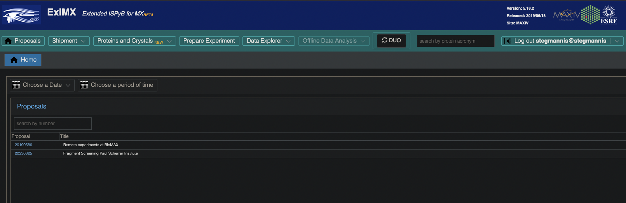
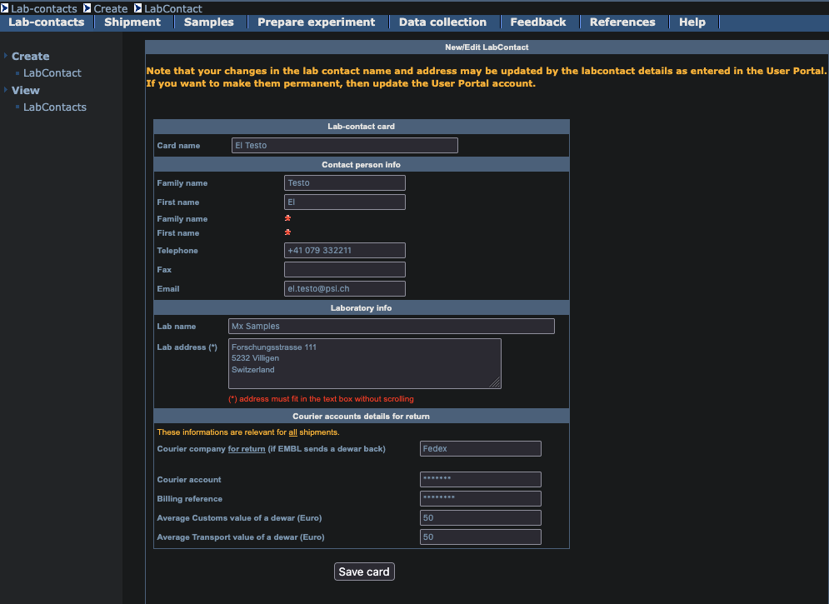
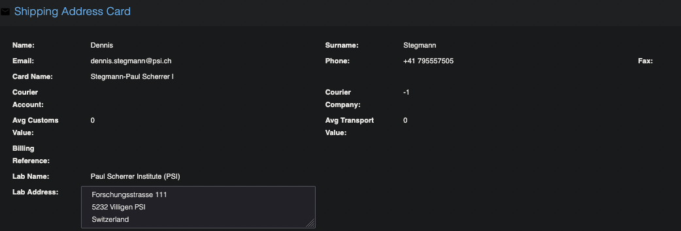
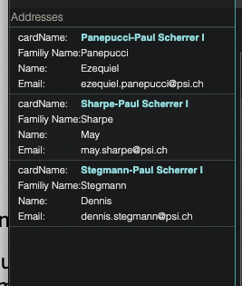
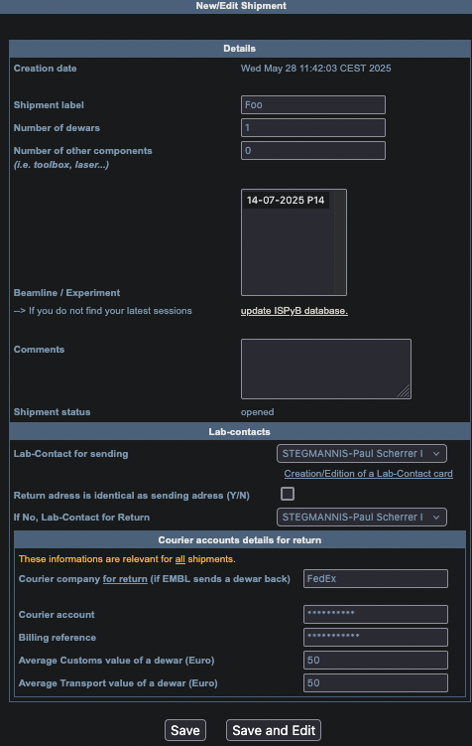
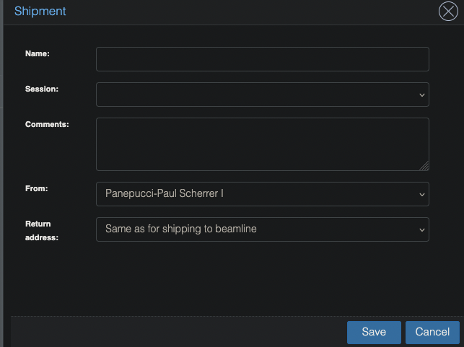
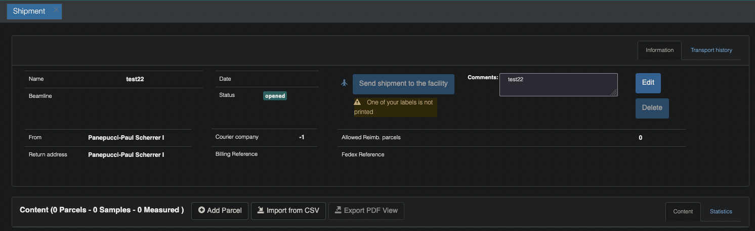
Setting up a shipment
class Shipment(BaseModel):
synchrotron: str
proposalNumber: str
beamline: str
shift: BeamTimeSession | None = None
dateBeamTime: datetime | None = None
shipmentName: str
courierCompany: str
courierAccount: str | None = None
trackingNumber: str | None = None
associatedSessionId: str
reimbursement: bool = False
comments: str | None = None
labContactUser: User #selected from a list provided by the synchrotron
returnAddress: str
userInstitution: str
parcels: list[Dryshipper]
class User(BaseModel):
name: str
surName: str
email: str
phone: str
fax: str | None = None
cardName: str
courierAccount: str
courierCompany: str
averageCustomsValueDewar: float | None = None
averageTransportValueDewar: float | None = None
billingReference: str | None = None
labName: str
labAddress: str
class LabContact(BaseModel):
cardName: str
login: User
familyName: str
firstName: str
phone: str
email: str
Institution: str
streetAddress: str
City: str
Postcode: str
Country: str
courierCompany: str
courierAccountnumber: str
billingReference: str
AverageCustomsValueDewar: float | None = None
averageTransportValueDewar: float | None = None
class Shipment(BaseModel):
shipmentName: str
numDewars: int
numOtherCompponents: int
beamline: str | None = None
experimentalSession: BeamTimeSession | None = None
labContactSending: LabContact
labContactReturn: LabContact | None
retAdrIdentSendAdr: bool = True
courierCompanyReturn: str | None = None
courierAccountReturn: str | None = None
billingReference: str | None = None
averageCustomsValueDewar: float | None = None
averageTransportValueDewar: float | None = None

Slide 11
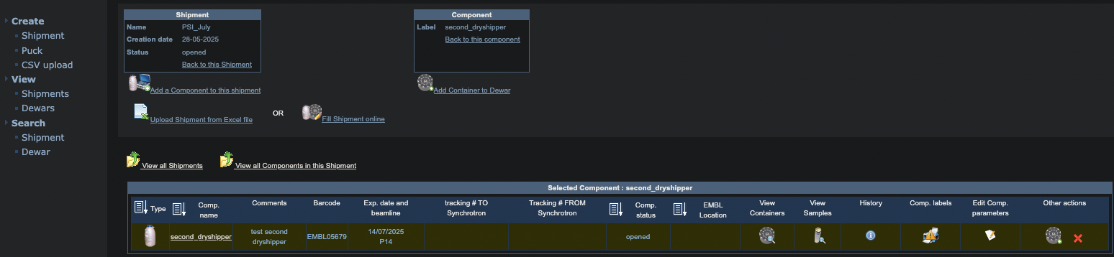
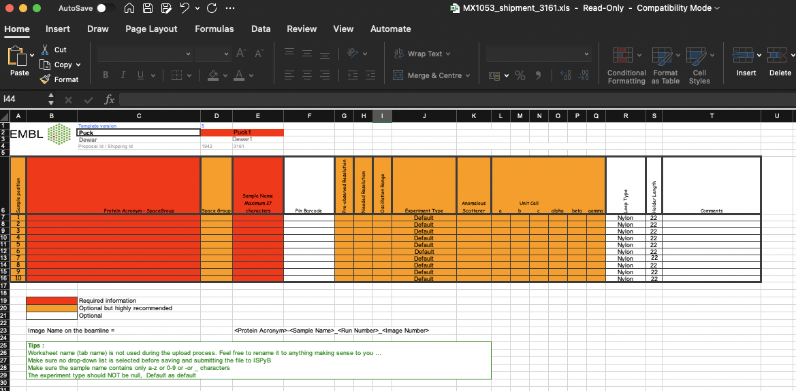
Setting up a shipment: Entering sample information
ISPyB
.csv
ExiMX
.xls

Slide 12
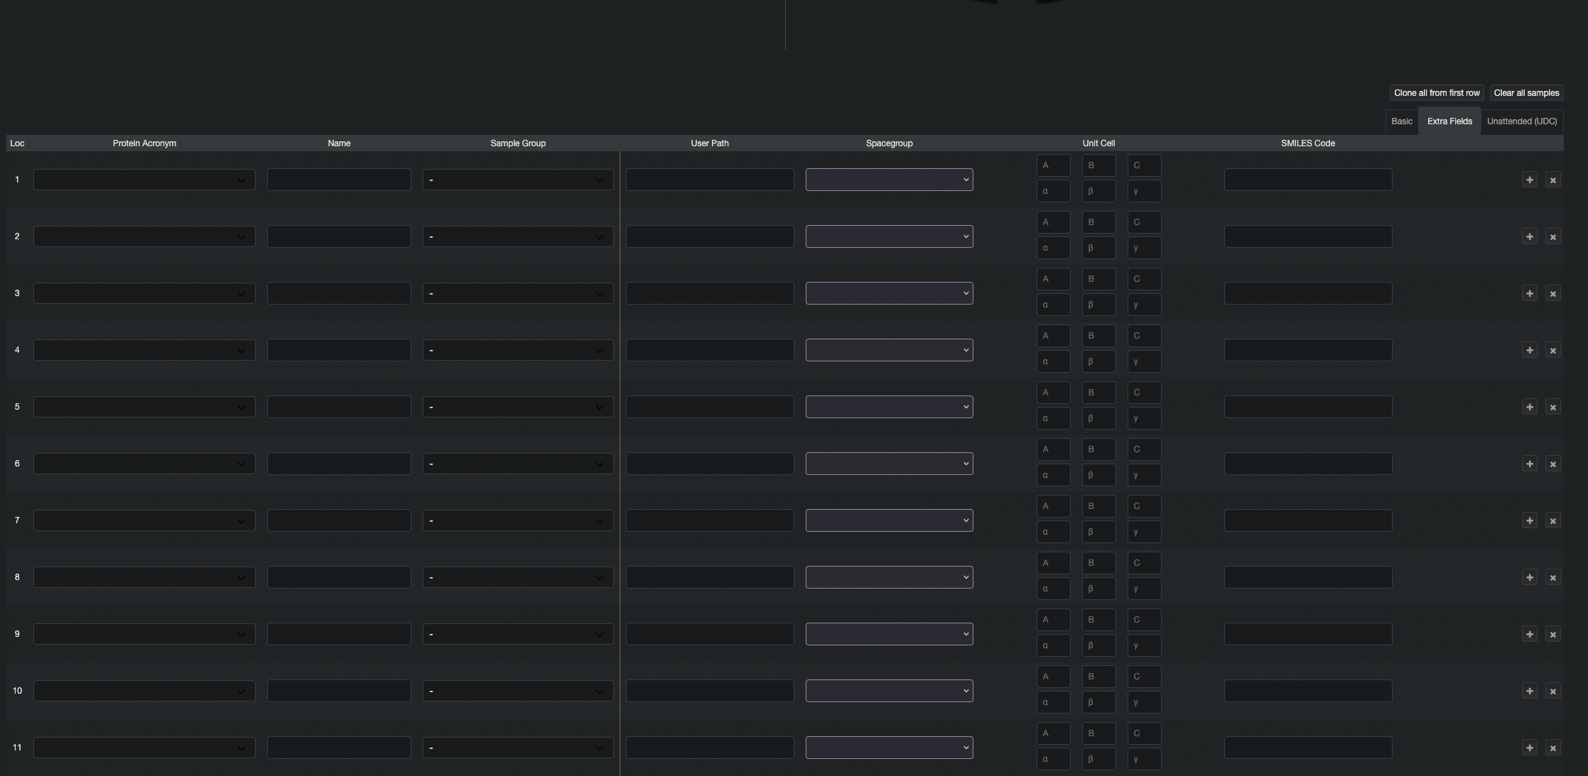
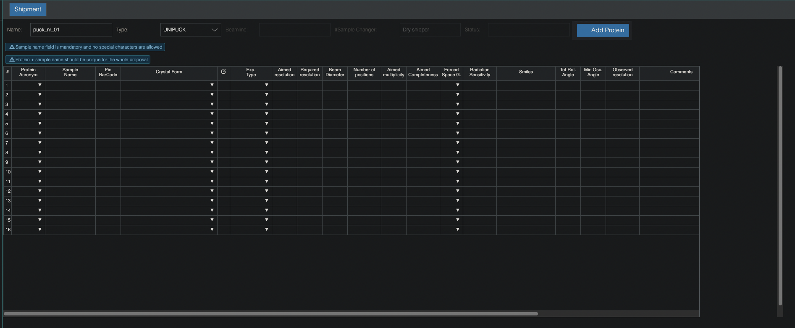
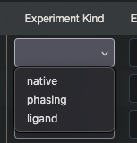
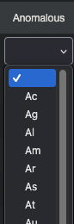
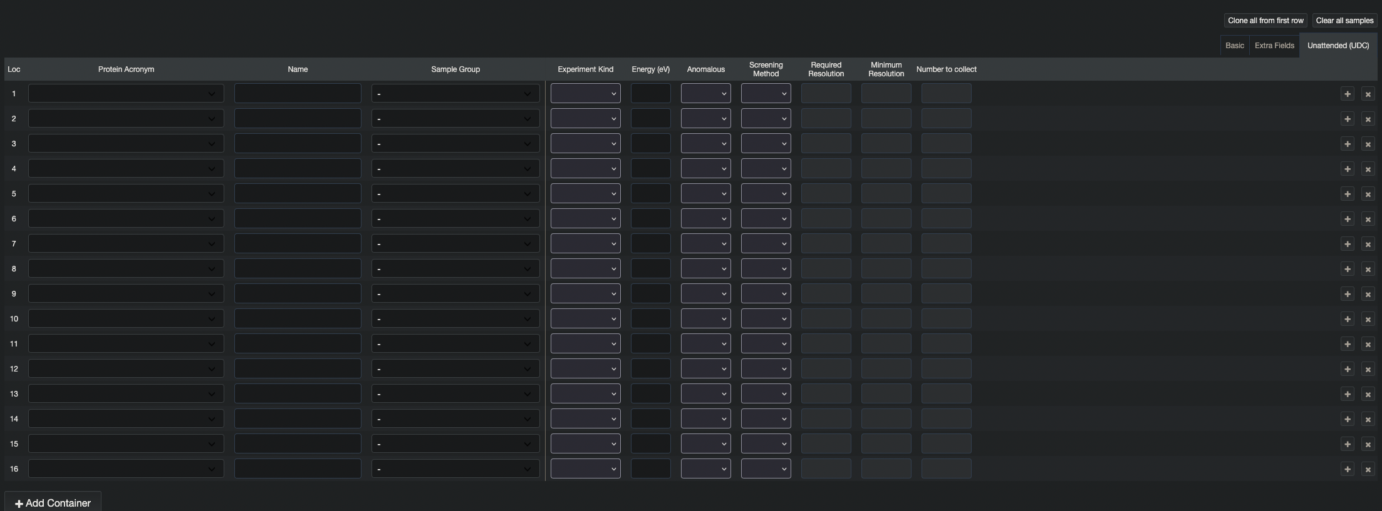
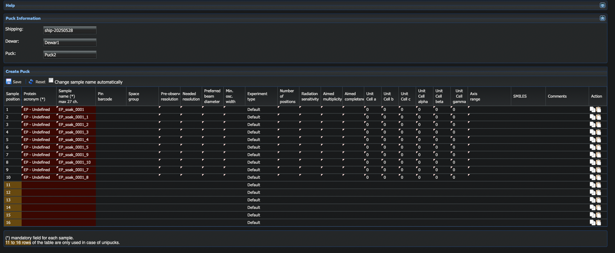
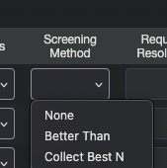
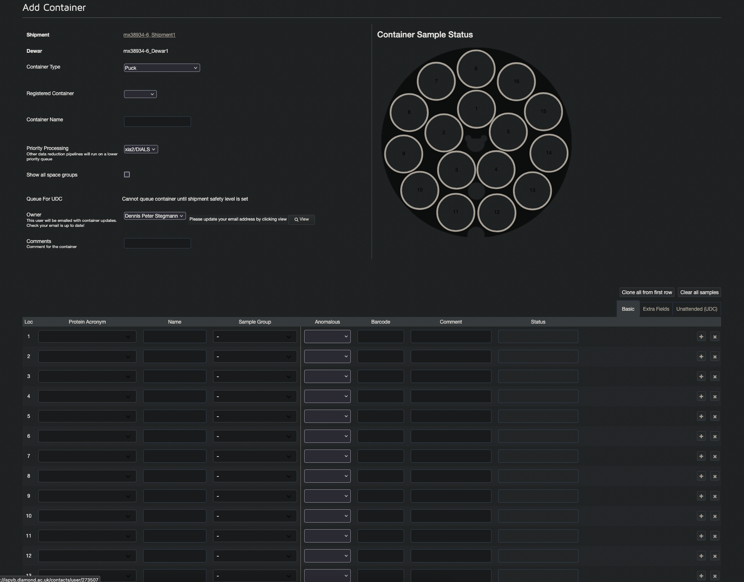
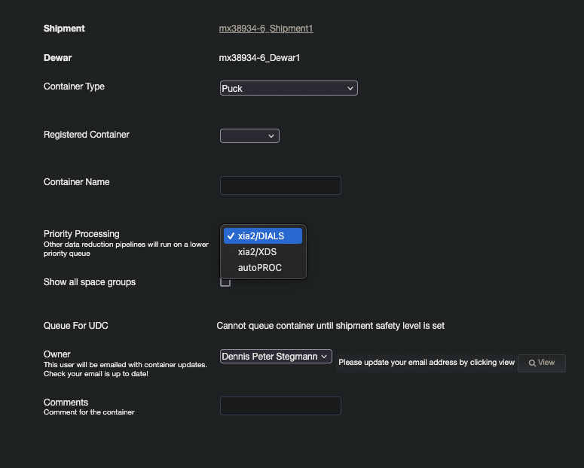
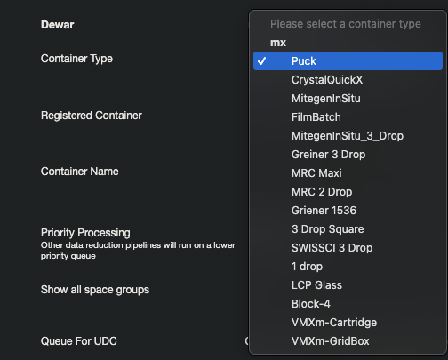
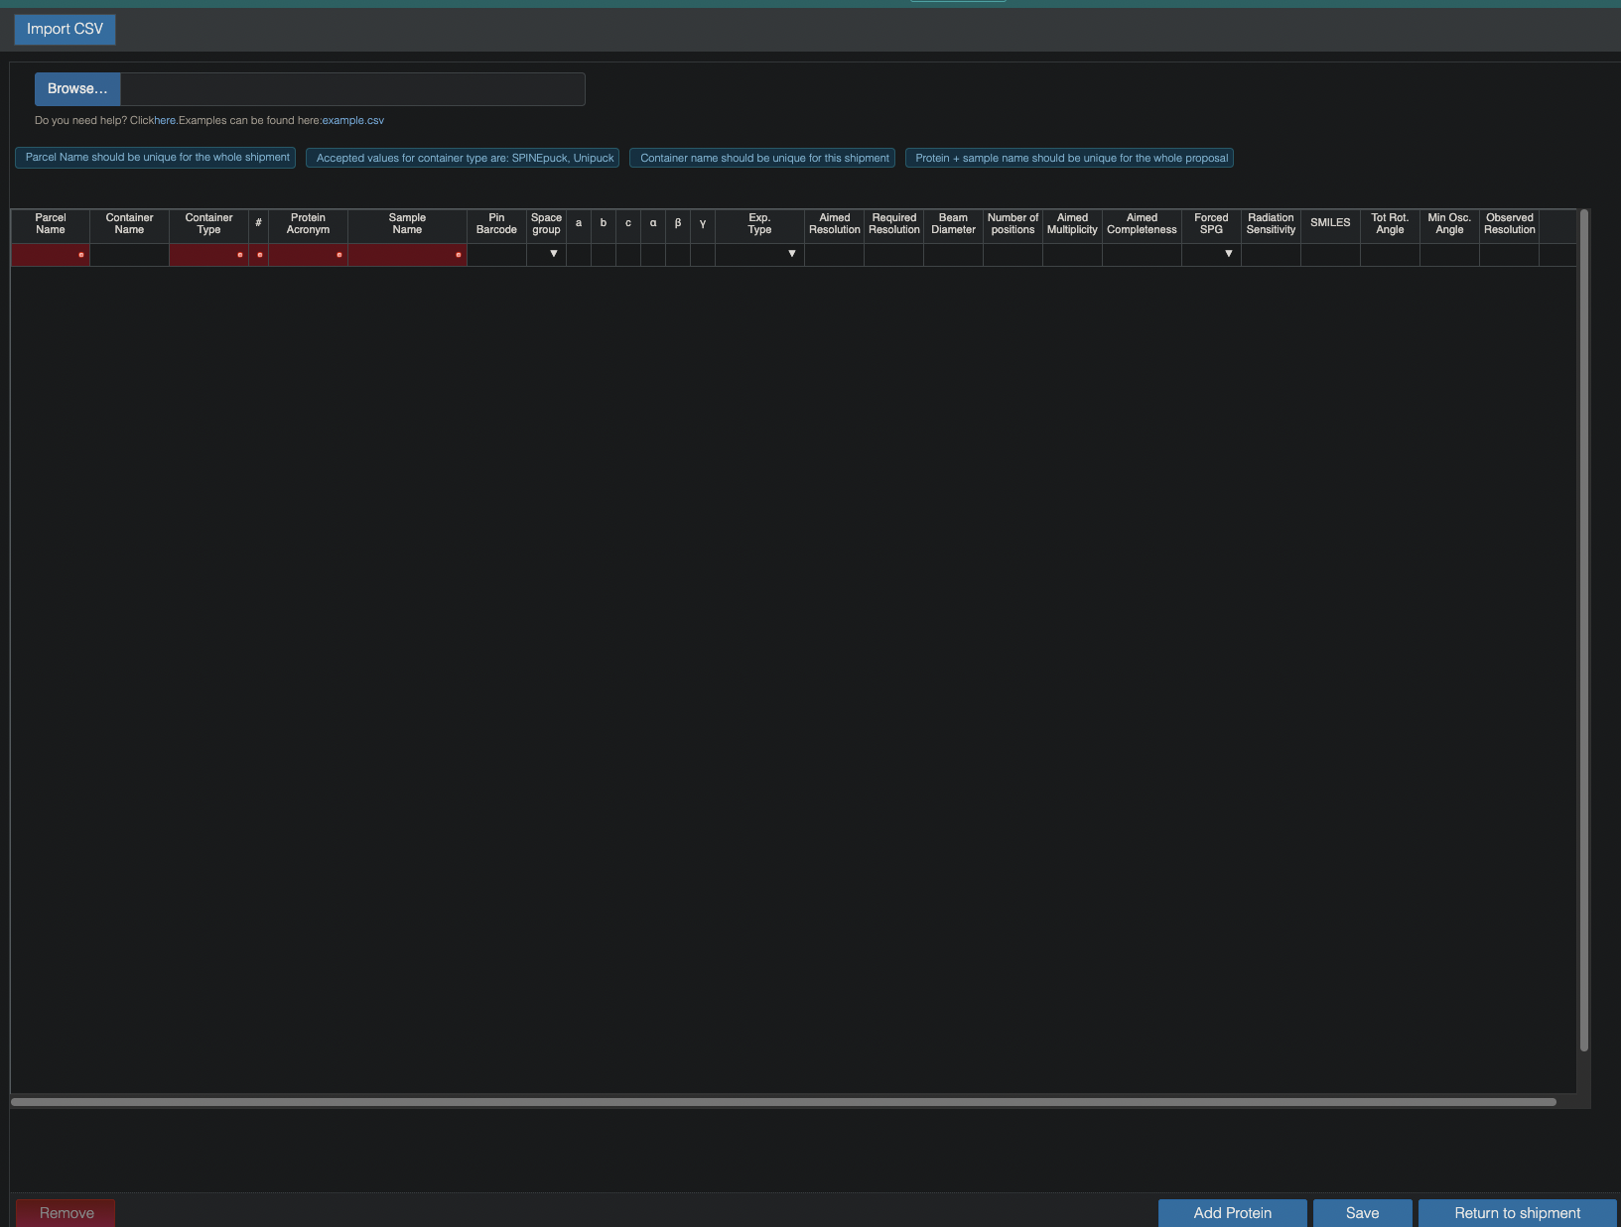
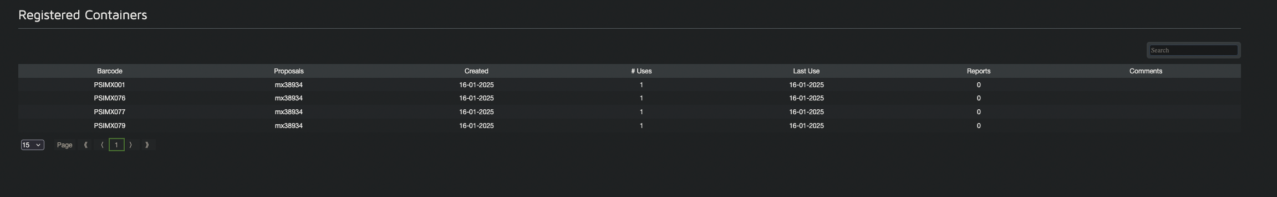
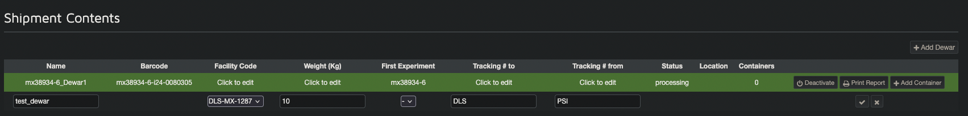
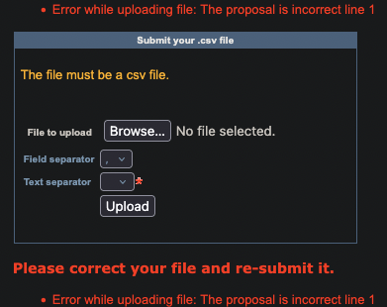

Entering sample information
manualy
via table-upload

Slide 13






Entering sample information manually
proteinAcronym: str
geometryClass: None | Literal["primitive triclinic",] "# etc, use enum
spaceGroup: str | None = None
cellA: float | None = None
cellB: float | None = None
cellC: float | None = None
cellAlpha: float | None = None
cellBeta: float | None = None
cellGamma: float | None = None
morphology: str | None = None
color: str | None = None
crystalSizeX: int | None = None
crystalSizeY: int | None = None
crystalSizeZ: int | None = None
comments: str | None = None
Digression extra-sample: the ISPyB sample i.e. crystal structure
avoid repetitive insertion of space group details
especially useful for entering samples manually, directly in the interface

Slide 14

Sample sheets and their file format
Write protected .xls: the siderophore
The .csv: flexible rigidity
not intended to be filled from scratch, write-protected fields prefilled with list[AllowedSampleAcronym]
ensures proposal and safety-office regulations (+ proper spelling -> safe connection to ISPyB database)
one puck is one sheet
blank example can often be downloaded
Table format, one line is one sample, puck is a normal field
site-dependent constrains for whitespace, headers etc
can be made even from scratch if header is known
large overlaps in some parts

Slide 15
Sample sheets and their content/requirements
Rules
Parcel name can not be empty and has to be unique for this shipment
Container name can not be empty and has to be unique for this shipment
Container type is a controlled list of values (case sensitive): Unipuck or Spinepuck
Sample position has to be an integer and depends on container type. If container type is Unipuck then accepted values are between 1 and 16. In case of Spinepuck values should be in the range of 1 and 10.
Protein has to be in the list of proteins of your proposal (case sensitive)
Sample name and the protein attached has to be unique for the whole proposal. That means that it will not be possible to have the same sample described twice in the same proposal (even from various shipments).
(*) Obligatory in all fields
#parcel name | container name | container type | container position | protein acronym | sample acronym | pin barcode | SPG | cellA | cellB | cellC | cellAlpha | cellBeta | Cell Gamma | Experiment Type | aimed Resolution | required Resolution | beam diameter | number of positions | aimed multiplicity | aimed completeness | forced SPG | radiation sensitivity | smiles | total rot. angle | min osc. angle | observed resolution | comments | energy | transmission | exposure time | oscillation range
 | (*) | (*) | (*) | (*) | (*)
proposalCode | proposalNumber | Visit Number | Shipping Name | Dewar Code | ContainerCode | preObs Resolution | neededResolution | oscillationRange | Protein Acronym | Protein Name | spaceGroup | Sample Barcode | Sample Name | Sample Position | Sample Comment | cell_a | cell_b | cell_c | cell_alpha | cell_beta | cell_gamma
(*) | (*) |  | (*) | (*) | (*) |  |  |  | (*) | (*) |  |  | (*) | (*)
#proposal Code | Proposal Number | Visit Number | Shipping Name | Dewar Code | Container Code | preObs Resolution | Needed Resolution | Oscillation Range | Protein Acronym | Protein Name | Space Group | Sample Barcode | Sample Name | Sample Position | Sample Comment | cell_a | cell_b | cell_c | cell_alpha | cell_beta | cell_gamma | subLocation | loopType | Required Resolution | Centring Method | Experiment Kind | radiationSensitivity | energy | userPath | screenAndCollectRecipe | screenAndCollectNValue | sampleGroup
(**) | (**) |  | (**) | (*) | (*) |  |  |  | (*) | (*) |  | (*) | (*) | (*)
#parcel name | container name | container type | container position | protein acronym | sample acronym | pin barcode | SPG | cellA | cellB | cellC | cellAlpha | cellBeta | cellGamma | experimentType | aimed Resolution | required Resolution | beam diameter | number of positions | aimed multiplicity | aimed completeness | forced SPG | radiation sensitivity | smiles | total rot. angle | min osc. angle | observed resolution | comments
(*) | (*) | (*) | (*) | (*) | (*) |  |  |  |  |  |  |  |  | Default | 1 | 2 |  |  |  |  |  | 100 |  |  | 0.2
Dewar Name* | Puck Name* | Puck Type* | PuckLocationInDewar* | Crystal Name* | Position InPuck* | Priority | Comments | PinBarcode | Directory | Protein Name [str] | Oscillation [deg] | Exposure [s] | Total Range [deg] | Transmission [%] | Target Resolution [A] | Data Collection Type [str] | Processing Pipeline [str] | Space Group Number [1x int] | Cell Parameters [6x real number] | Res Cut Key [str] | Res Cut Value [float] | PDB Model [str] | Autoproc Full [bool] | Autoproc Extra Params [str] | No Ano [bool] | Trusted High [floatl] | FFCS campaign [bool]
(*) | (*) |  |  | (*) | (*)
Sample position | Protein name | Protein Acronym | Space Group | Sample Name | Pin Barcode | Pre-observed Resolution | Needed Resolution | Oscillation Range | Experiment Type | Anomalous Scatterer | a | Unit Cell b c |  | alpha | beta | gamma | Loop Type | Holder Length | Comments
1 |  |  |  |  |  |  |  |  | OSC |  |  |  |  |  |  |  | Nylon | 22
2 |  |  |  |  |  |  |  |  | OSC |  |  |  |  |  |  |  | Nylon | 22
Details matter:
newline characters
HeaderExists True/False

Slide 16
Sample sheets and their content: samples
class SampleManualEntry(BaseModel):
samplePosition: int = Field(..., ge=1, le=10) # (*)
proteinAcronym: str = Field(..., ge=1, le=6) # (*)
SampleName: str = Field(..., le=27) #(*) max 27 ch.
PinBarcode: str | None = None
SpaceGroup: str | None = None
PreobservedResolution: float | None = None
NeededResolution: float | None = None
PreferredBeamDiameter: int | None = None
MinOscWidth: int | None = None
ExperimentType: Literal["default"] #and others, that I dont know of
NumberOfPositions: int | None = None
RadiationSensitivity: str | None = None
AimeMultiplicity: int | None = None
AimedCompleteness: int | None = None
unitCellA: float | None = None
unitCellB: float | None = None
unitcellC: float | None = None
unitCellAlpha: float | None = None
uniCellBeta: float | None = None
unitCellGamma: float | None = None
axisRange: int | None = None
smiles: str | None = None
comments: str | None = None
class Sample(BaseModel):
puckLocation: int
proteinAcronym: str # must be present in ApprovedSample dict
sampleName: str
samlpeGroup: str
Anomalous: Literal[Element] # enum of elements
Barcode: str
Comment: str
userPath: str | None = None
spaceGroup: str | None = None
cellA: float | None = None
cellB: float | None = None
cellC: float | None = None
cellAlpha: float | None = None
cellBeta: float | None = None
cellGamma: float | None = None
smiles: str | None = None
experimentKind: Literal["native", "phasing", "ligand"]
Energy: float | None = None
anomalous: Literal[Element] | None = None
screeningMethod: Literal["None", "Better Than", "Collect Best N"] | None = None
requiredResolution: float | None = None
minimumResolution: float | None = None
numberToCollect: int | None = None
class Sample(BaseModel):
sampleAcronym: ApprovedSample
sampleName: str
pinBarcode: str | None = None
spacegroup: str | None = None
cellA: float | None = None
cellB: float | None = None
cellC: float | None = None
cellAlpha: float | None = None
cellBeta: float | None = None
cellGamma: float | None = None
experimentType: str | None = “Default”
aimedResolution: float | None = None
requiredResolution: float | None = None
beamDiameter: int | None = None
numberOfPositions: int | None = None # I dont know what this stands for
aimedMultiplicity: int | None = None
aimedCompleteness: int | None = None
forcedSPG: str | None = None
radiationSensitivity: str | None = None # I dont know what metric is used here
smiles: str | None = None
totalRotAngle: int | None = 360
minOscAngle: int | None = None
observedResolution: float | None = None
comments: str | None = None
energy: float | None = None
transmission: float | None = 100.0 #in percent
exposureTime: float | None = 0.02 #in seconds per frame
oscillationRange: float | None = 0.1 #in degrees per frame
class Sample(BaseModel):
samplePosition: int
proteinName: str
proteinAcronym: Literal["enum_of_allowed_acronyms"]
spaceGroup: str | None = None
sampleName: str
pinBarcode: str | None = None
preobservedResolution: float | None = None
neededResolution: float | None = None
oscRange: float | None = None
experimentType: Literal["OSC", "SAD", "MAD"]
anomalousScatterer: str | None = None
cellA: float | None = None
cellB: float | None = None
cellC: float | None = None
cellAlpha: float | None = None
cellBeta: float | None = None
cellGamma: float | None = None
loopType: str | None = None
holderLength: int | None = None
comments: str | None = None
class Sample(BaseModel):
acronym: AllowedAcronym #one of the ApprovedSamples
sampleName: str
pinBarCode: str | None = None
crystalForm: str | None = None
comments: str | None = None
experimentType: Literal["MXPressE", "MXPressF", "MXPressO", "MXPressI", "MXPressE_SAD", "MXScore", "MXPressM", "MXPressP", "MXPressP_SAD"]
amiedResolution: float | None = None
requiredResolution: float | None = None
beamDiameter: int | None = None
numberOfPositions: int | None = None
amiedMultiplicity: int | None = None
aimedCompleteness: float | None = None
forcedSpacegroup: Literal["P1", "P2", "..."]
radiationSensitivity: str | None = None
smiles: str | None = None
totalRotationAngle: float | None = None
minOscAngle: float | None = None
observedResolution: float | None = None

Slide 17
Retrieve Data: raw images and meta-info
Retrieve data via rsync or Globus
Reingestion of data into database:
currently requires individual script for each synchrotron
based on filenames and folder logic (error prone!)
string slicing and sorting (error prone and reliant on little changes in file naming conventions)
extraction of meta-data from file and folder-names, headers, results files and notes

Slide 18


A central, site-indifferent translation tool: MXLIMS
Lab
Synchrotron
physical logistics
crystal shipment
data logistics
data formats required by different synchrotrons: different keys and values!
A1 :
A2 :
MXLIMS data model:
remapping &
translation
C :
B :
user input data
A :
user input
Ac :
B :
# MXLIMS model
Cb :
C :
synchrotron output
import json
Ab :
from pydantic import …
class CrystalData(Base…
A :
name: str | None = …
…
B :
C :

Slide 19




MXLIMS at the FFCS
{
"Dewar": {
"Dewar1": {
"version": "0.6.8",
"mxlimsType": "Dewar",
"uuid": "50cd9c6b-6276-4153-9e4a-3aa7a86c2b93",
"name": "blue_round_PSI_01",
"containerId": "c4fa5683-8217-46db-8e53-6eab445977d0",
"barcode": "blue_round_PSI_01"
}, […] }
"Macromolecule": {
"Macromolecule1": {
"version": "0.6.8",
"mxlimsType": "Macromolecule",
"uuid": "d4d36044-d758-4c7b-bb2a-ad2129a1c8ec",
"acronym": ”my_protein"
}, […]}
"MacromoleculeSample": {
"MacromoleculeSample1": {
"version": "0.6.8",
"mxlimsType": "MacromoleculeSample",
"uuid": "e019dda0-740b-49ab-9d1d-fe3440665914",
"name": ”my_protein_01-1",
"mainComponentId": "d4d36044-d758-4c7b-bb2a-ad2129a1c8ec"
}, […] }
"Pin": {
"Pin1": {
"version": "0.6.8",
"mxlimsType": "Pin",
"uuid": "7c32cb5b-14ae-47df-adfc-0a0e8c9270b5",
"sampleId": "e019dda0-740b-49ab-9d1d-fe3440665914",
"containerId": "3e9db592-b0d4-4bee-bedd-42f99d6d1f31",
"positionInPuck": 1
}, […] }
"Puck": {
"Puck1": {
"version": "0.6.8",
"mxlimsType": "Puck",
"uuid": "744b2908-e3fa-4672-96a3-f4ab37457ba9",
"name": "CFSLS108",
"containerId": "50cd9c6b-6276-4153-9e4a-3aa7a86c2b93",
"barcode": "CFSLS108",
"numberPositions": 16,
"puckType": "Unipuck"
}, […] }
"Shipment": {
"Shipment1": {
"version": "0.6.8",
"mxlimsType": "Shipment",
"uuid": "c4fa5683-8217-46db-8e53-6eab445977d0",
"proposalCode": "20230325",
"labContactOutbound": {
"name": "Dennis_Stegmann",
"emailAddress": "dennis.stegmann@psi.ch",
"phoneNumber": "+41-563104699"
},
"labContactReturn": {
"name": "Dennis_Stegmann",
"emailAddress": "dennis.stegmann@psi.ch",
"phoneNumber": "+41-563104699"
}
}
}
Example shipment message
json.dump(data)
dict[str, dict[str, str | int | float]
Pydantic
Model(**data)

Slide 20
MXLIMS at the FFCS
class SampleFlattened(BaseModel):
"""Flattened view of mxlims.pydantic.objects.Sample.Sample (installed)"""
model_config = ConfigDict(populate_by_name=True, extra='forbid’)
acronym: Optional[str] = Field(None, description='Acronym - short synonym for Sample', title='Acronym')
annotation: Optional[str] = Field(None, description='Comment or annotation.', title='Annotation')
campaign_name: Optional[str] = Field(None, alias="campaignName")
components: Optional[List[SampleComponent]] = Field(None, description='Other components of Sample', title='Sample components')
extensions: Optional[Dict[str, Any]] = Field(None, description='Keyword-value dictionary string:Any of extensions. Use is accepted but discouraged', title='Extensions')
identifiers: Optional[Dict[str, str]] = Field(None, description="Dictionary str:str of contextName: identifier. ContextName will typically refer to a LIMS, database, or web site but could also be e.g. 'smiles' or 'sequence'", title='Identifiers')
main_component_id: Optional[UUID] = Field(None, alias="mainComponentId")
medium_id: Optional[UUID] = Field(None, alias="mediumId")
mxlims_base_type: Literal['Sample'] = Field('Sample', alias="mxlimsBaseType", exclude=True, frozen=True)
mxlims_type: str = Field('Sample', alias="mxlimsType", frozen=True)
name: Optional[str] = Field(None, description='Sample human-readable name or acronym.', title='Name')
namespaced_extensions: Optional[List[NamespacedExtensionData]] = Field(None, alias="namespacedExtensions")
uuid: Optional[UUID] = Field(default_factory=uuid1, description='Permanent unique identifier string', title='Uuid', frozen=True)
version: Literal['0.6.8'] = Field('0.6.8', description='MXLIMS version for current model', title='Version')
class MxlimsMessageFlattened(BaseModel):
"""Flattened view of mxlims.pydantic.messages.MxlimsMessage.MxlimsMessage (installed)"""
model_config = ConfigDict(populate_by_name=True, extra='forbid')
collection_sweep: Optional[Dict[str, CollectionSweep]] = Field(default_factory=builtins.dict, alias="CollectionSweep")
crystal: Optional[Dict[str, Crystal]] = Field(default_factory=builtins.dict, alias="Crystal")
dataset: Optional[Dict[str, DatasetStub]] = Field(default_factory=builtins.dict, alias="Dataset")
dewar: Optional[Dict[str, Dewar]] = Field(default_factory=builtins.dict, alias="Dewar")
drop_region: Optional[Dict[str, DropRegion]] = Field(default_factory=builtins.dict, alias="DropRegion")
job: Optional[Dict[str, JobStub]] = Field(default_factory=builtins.dict, alias="Job")
logistical_sample: Optional[Dict[str, LogisticalSampleStub]] = Field(default_factory=builtins.dict, alias="LogisticalSample")
macromolecule: Optional[Dict[str, Macromolecule]] = Field(default_factory=builtins.dict, alias="Macromolecule")
macromolecule_sample: Optional[Dict[str, MacromoleculeSample]] = Field(default_factory=builtins.dict, alias="MacromoleculeSample")
medium: Optional[Dict[str, Medium]] = Field(default_factory=builtins.dict, alias="Medium")
multi_pin: Optional[Dict[str, MultiPin]] = Field(default_factory=builtins.dict, alias="MultiPin")
mx_experiment: Optional[Dict[str, MxExperiment]] = Field(default_factory=builtins.dict, alias="MxExperiment")
mx_processing: Optional[Dict[str, MxProcessing]] = Field(default_factory=builtins.dict, alias="MxProcessing")
pin: Optional[Dict[str, Pin]] = Field(default_factory=builtins.dict, alias="Pin")
pin_position: Optional[Dict[str, PinPosition]] = Field(default_factory=builtins.dict, alias="PinPosition")
plate: Optional[Dict[str, Plate]] = Field(default_factory=builtins.dict, alias="Plate")
plate_well: Optional[Dict[str, PlateWell]] = Field(default_factory=builtins.dict, alias="PlateWell")
puck: Optional[Dict[str, Puck]] = Field(default_factory=builtins.dict, alias="Puck")
reflection_set: Optional[Dict[str, ReflectionSet]] = Field(default_factory=builtins.dict, alias="ReflectionSet")
sample: Optional[Dict[str, SampleStub]] = Field(default_factory=builtins.dict, alias="Sample")
shipment: Optional[Dict[str, Shipment]] = Field(default_factory=builtins.dict, alias="Shipment")
volume_scan: Optional[Dict[str, VolumeScan]] = Field(default_factory=builtins.dict, alias="VolumeScan")
well_drop: Optional[Dict[str, WellDrop]] = Field(default_factory=builtins.dict, alias="WellDrop")
class LogisticalSampleFlattened(BaseModel):
"""Flattened view of mxlims.pydantic.objects.LogisticalSample.LogisticalSample (installed)"""
model_config = ConfigDict(populate_by_name=True, extra='forbid’)
annotation: Optional[str] = Field(None, description='Comment or annotation.', title='Annotation')
container_id: Optional[UUID] = Field(None, alias="containerId")
extensions: Optional[Dict[str, Any]] = Field(None, description='Keyword-value dictionary string:Any of extensions. Use is accepted but discouraged', title='Extensions')
mxlims_base_type: Literal['LogisticalSample'] = Field('LogisticalSample', alias="mxlimsBaseType", exclude=True, frozen=True)
mxlims_type: str = Field('LogisticalSample', alias="mxlimsType", frozen=True)
name: Optional[str] = Field(None, description='Human-readable name.', title='Name')
namespaced_extensions: Optional[List[NamespacedExtensionData]] = Field(None, alias="namespacedExtensions")
sample_id: Optional[UUID] = Field(None, alias="sampleId")
uuid: Optional[UUID] = Field(default_factory=uuid1, description='Permanent unique identifier string', title='Uuid', frozen=True)
version: Literal['0.6.8'] = Field('0.6.8', description='MXLIMS version for current model', title='Version')
Pydantic
Model(**data)
class JobFlattened(BaseModel):
"""Flattened view of mxlims.pydantic.objects.Job.Job (installed)"""
model_config = ConfigDict(populate_by_name=True, extra='forbid')
annotation: Optional[str] = Field(None, description='Comment or annotation.', title='Annotation')
end_time: Optional[datetime] = Field(None, alias="endTime")
extensions: Optional[Dict[str, Any]] = Field(None, description='Keyword-value dictionary string:Any of extensions. Use is accepted but discouraged', title='Extensions')
input_data_ids: Optional[List[UUID]] = Field(default_factory=builtins.list, alias="inputDataIds")
job_status: Optional[JobStatus] = Field(None, alias="jobStatus")
logistical_sample_id: Optional[UUID] = Field(None, alias="logisticalSampleId")
mxlims_base_type: Literal['Job'] = Field('Job', alias="mxlimsBaseType", exclude=True, frozen=True)
mxlims_type: str = Field('Job', alias="mxlimsType", frozen=True)
namespaced_extensions: Optional[List[NamespacedExtensionData]] = Field(None, alias="namespacedExtensions")
reference_data_ids: Optional[List[UUID]] = Field(default_factory=builtins.list, alias="referenceDataIds")
sample_id: Optional[UUID] = Field(None, alias="sampleId")
start_time: Optional[datetime] = Field(None, alias="startTime")
started_from_id: Optional[UUID] = Field(None, alias="startedFromId")
template_data_ids: Optional[List[UUID]] = Field(default_factory=builtins.list, alias="templateDataIds")
uuid: Optional[UUID] = Field(default_factory=uuid1, description='Permanent unique identifier string', title='Uuid', frozen=True)
version: Literal['0.6.8'] = Field('0.6.8', description='MXLIMS version for current model', title='Version')

Slide 21

The sample pyramide flattened into dictionaries
full json message
Shipments: {}
uuid
Dewars: {}
uuid
…
Pucks: {}
uuid
Pins: {}
uuid
…
…
MacromoleculeSample: {}
uuid
Pins: for special experiments, e.g. multi-loop pins
MacromolecularSample: because not all loops contain (only) one crystal
or: is a crystal proven as a crystal, if noone hears it being collected?
Macromolecule
uuid
Job
uuid
Crystal1
Crystal2
…

Slide 22

Outlook re-ingestion of data
Convert data collection info to mxlims model
Replaces planned data model on our side
Still requires data extraction script for each individual setup, but re-ingestion standardised from that point on
individual folder structure &
file naming conventions
extract scripts
# MXLIMS model
import json
re-ingest
from pydantic import …
class CrystalData(Base…
name: str | None = …
…
central model

Slide 23

Thanks!
SLS
May Sharpe
Kate Smith
MX group
MXLIMS
Gérard Bricogne
Rasmus Fogh
Edward Daniel
Ezequiel Panepucci
Guilherme De Freitas
Photo by Zac Panepucci

Slide 25






The FFCS Software
Virtualize experiments
object in database
crystal plate
Offset targeting
crystal
offset X-Y- coordinates
selected target coordinates
Combine ligands & crystals
FFCS DB Server
…
dispensing protocol
XY- coordinates
selected fragments
harvesting protocol
Soaking experiments
dispensing protocol
harvesting protocol
dispensing results
fishing results
fishing results
Echo
results file

Slide 26
Principles of Fragment Based Drug Discovery
simpler compounds cover a larger share of chemical space per molecule
more promiscuous binders, higher hit rates, druggability mapping of target-protein surface
low overall affinity: grow/merge/link to increase potency towards lead compound
strong individual interactions discovered to overcome rigid body entropy barrier
Crystal based fragment screening: high information content
binding poise
growth vectors
individual interactions
binding site
reduced false positives
target

Slide 27


Flavors of ISPyB: user sample info transfer to synchrotron database
Different user portals
Different proposal systems
Different safety requirements
Different input Sample upload methods (spreadsheet and web interface)

